Slide 1

Terraform
Parameswari Ettiappan

Slide 2
Course Content
Understand Infrastructure as Code (IaC) concepts
Infrastructure Automation
What is Infrastructure as Code and why is it needed?
Declarative versus procedural tools for Infrastructure as Code
Infrastructure as Code in a Private or Public Cloud
Requirements for infrastructure provisioner
Which tools exist for infrastructure provisioning?
A short overview of Terraform

Slide 3
Course Content
Deploying First Server
Preparing work environment
Configuring Terraform providers
Configuring AWS provider
Creating an EC2 instance with Terraform
Working with state
Handling resource updates
Destroying Everything we have built

Slide 4
Course Content
Resource Dependencies and Modules
Creating an AWS Virtual Private Cloud
Understanding dependency graph
Playing with Terraform graphs
Controlling dependencies with depends_on and ignore_changes
Removing duplication with modules
Configuring modules
Retrieving module data with outputs
Using root module outputs

Slide 5
Course Content
Storing and Supplying Configuration
Storing and Supplying Configuration
Understanding variables
Configuring data sources
Exploring Terraform configuration resources
Taking a quick look at Consul

Slide 6
Course Content
Collaborative Infrastructure
Version control with Git
Moving templates to Git
Protecting secrets in a Git repository
Storing state files remotely
Connecting remote states together
Storing modules remotely
Locking state files with Terragrunt
Moving infrastructure updates to the CI pipeline
Integration testing of Terraform modules

Slide 7

Terraform

Slide 8
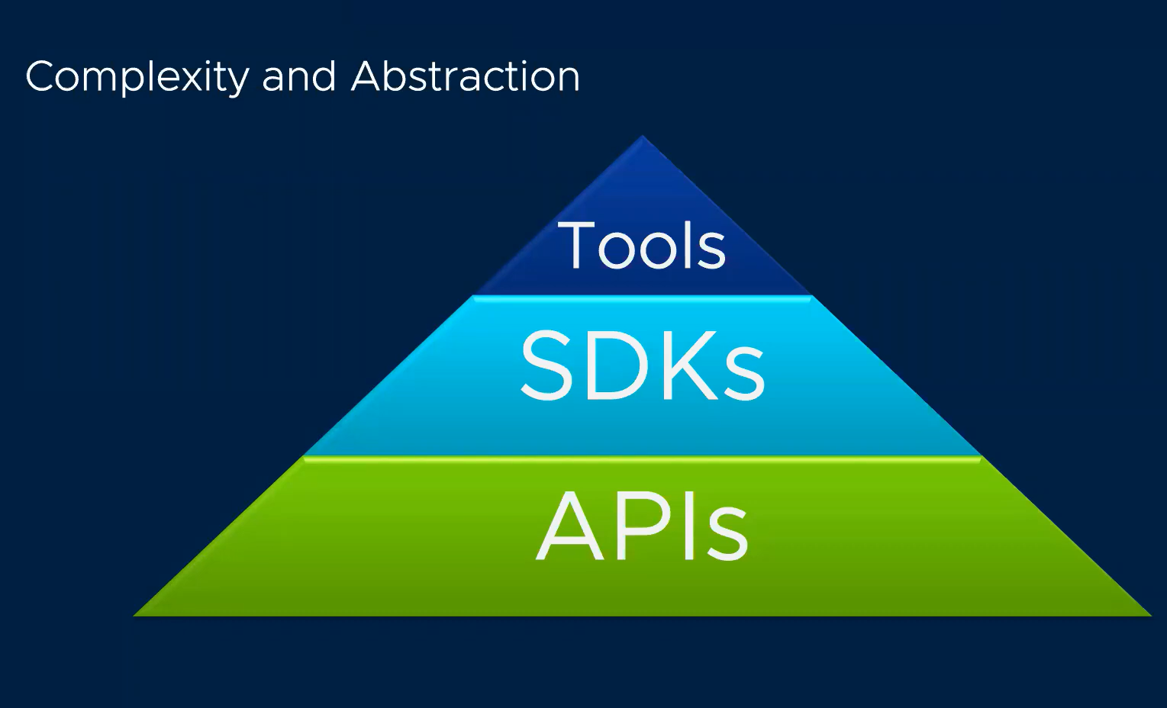

Slide 9
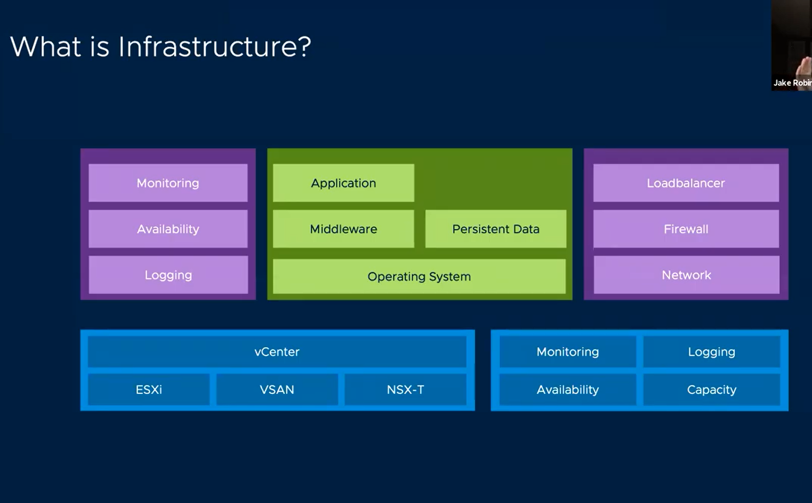

Slide 10
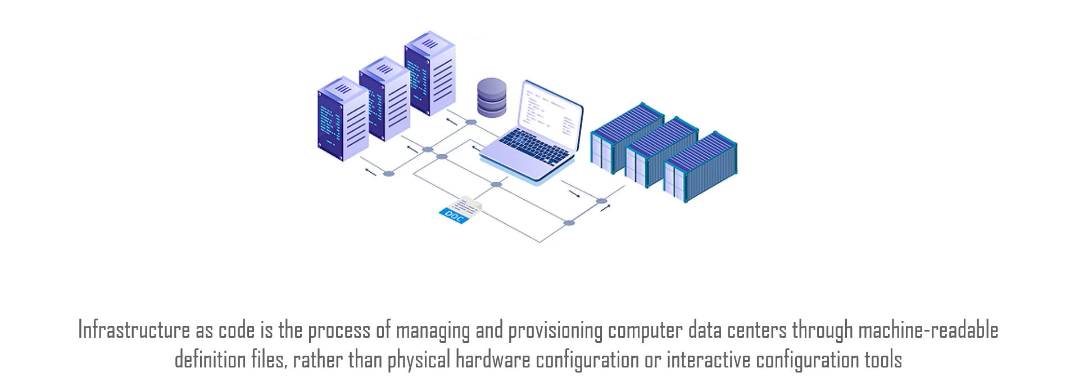
What Is IaC

Slide 11
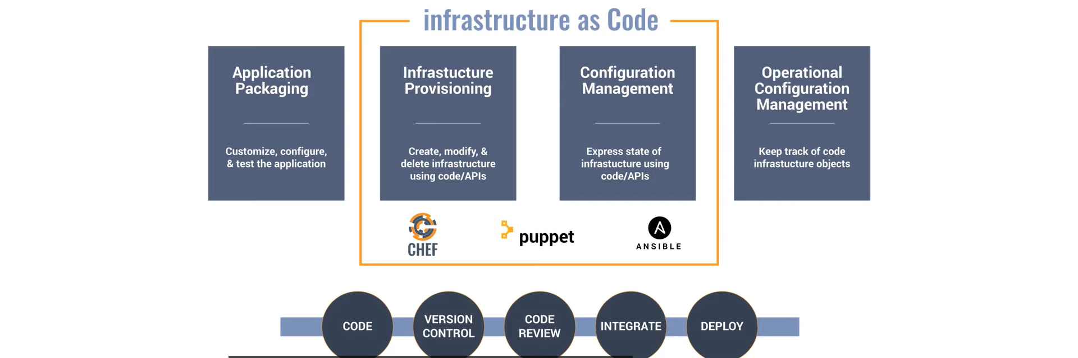
How IaC Works

Slide 12

Benefits of IaC

Slide 13
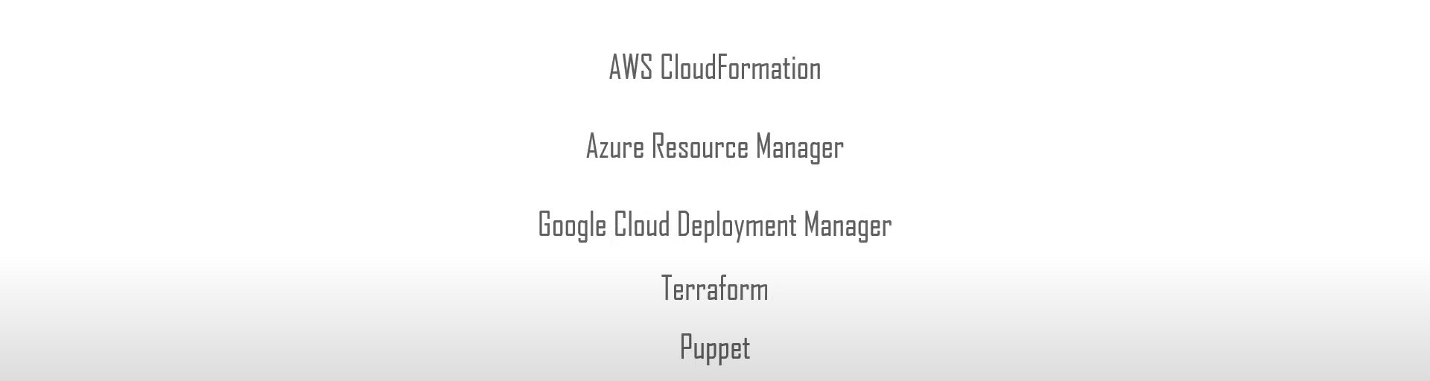
IaC Tools
Ansible, Chef etc.,

Slide 14
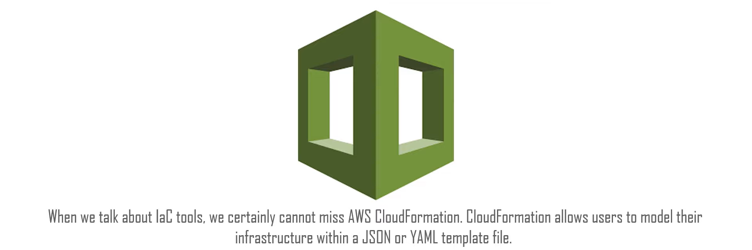
IaC Tools

Slide 15
Procedural vs Declarative
Chef and Ansible encourage a procedural style where you write code that specifies, step-by-step, how to to achieve some desired end state.
Terraform, CloudFormation, SaltStack, and Puppet all encourage a more declarative style where you write code that specifies your desired end state.
IAC tool itself is responsible for figuring out how to achieve that state.

Slide 16
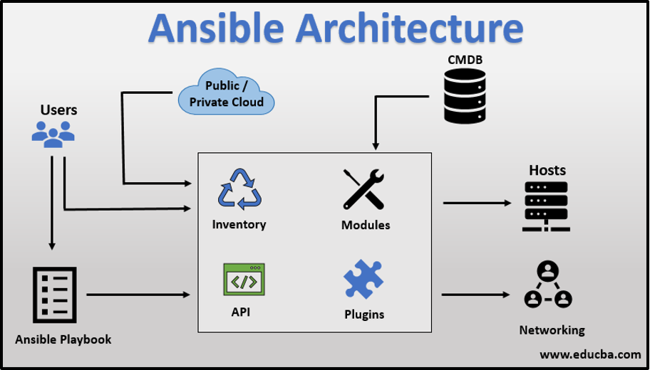

Slide 17
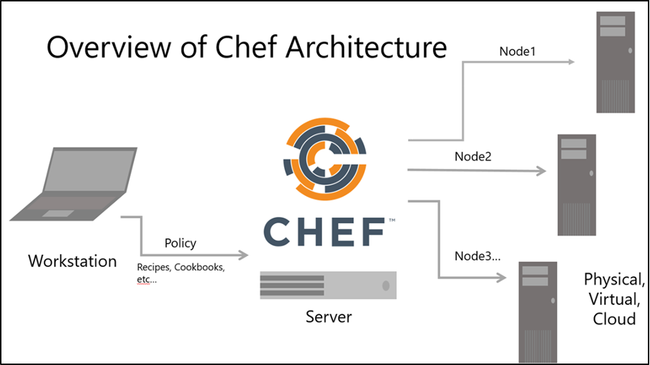

Slide 18
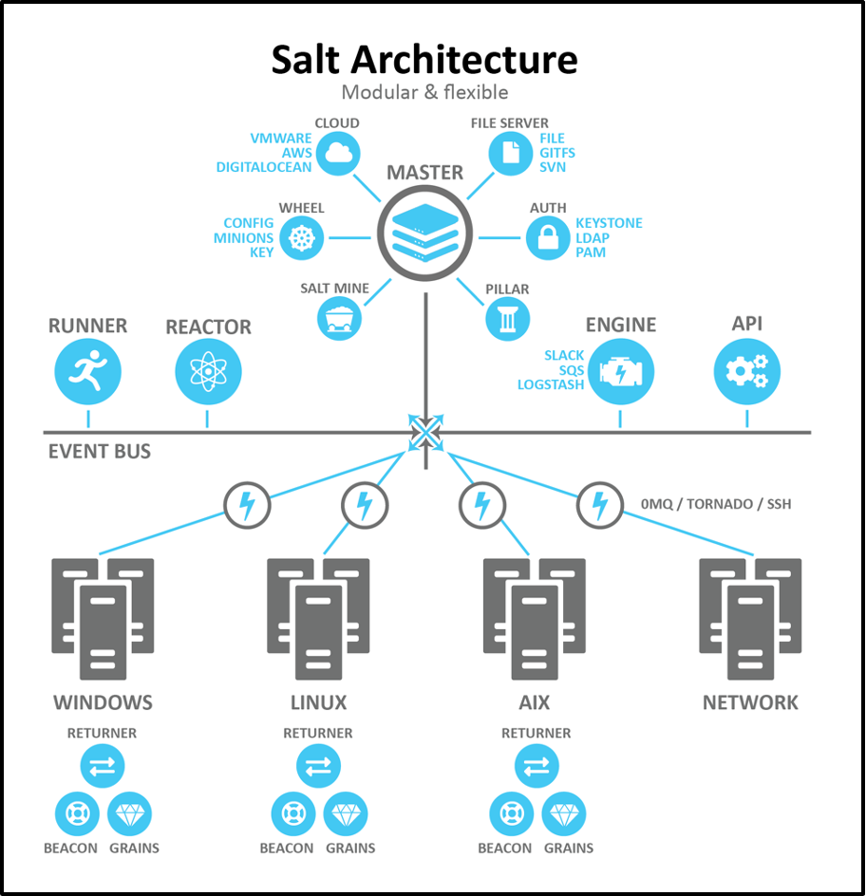

Slide 20
Terraform
Terraform is a multi-cloud (IaC) Infrastructure as Code software by HashiCorp written in Go Language using (HCL) HashiCorp Config Language.
An open source command line tool can be used to provide an infrastructure on many different platforms and services such as IBM, AWS, GCP, Azure, OpenStack, VMware and more.
By using a plugin-based model to support providers and provisioners, it gives the ability to support almost any service that exposes APIs.

Slide 21
Terraform
It is a cloud-agnostic tool that elegantly defines your IaC, simple and yet powerful; Terraform allows you to build complex, version controlled, collaborative, heterogeneous and disposable systems with very high productivity.
It provides built-in dependencies between each tier that handle automatic provisioning of infrastructure, both in the public and private cloud.
Whereas configuration management and server templating tools define the code that runs on each server, server provisioning tools such as Terraform, CloudFormation, and OpenStack Heat are responsible for creating the servers themselves.

Slide 22
Terraform
In fact, you can use provisioning tools to not only create servers, but also databases, caches, load balancers, queues, monitoring, subnet configurations, firewall settings, routing rules, SSL certificates, and almost every other aspect of your infrastructure.

Slide 23
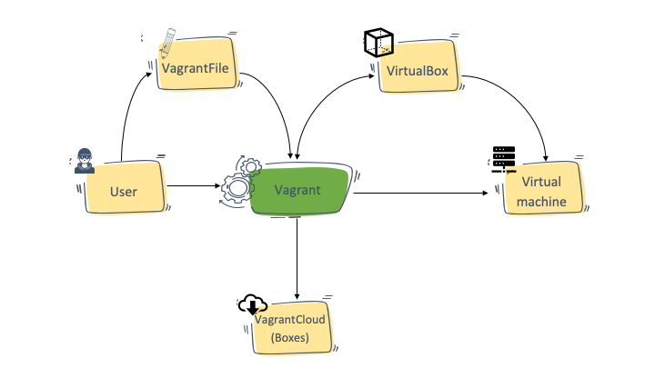
Vagrant Architecture

Slide 24
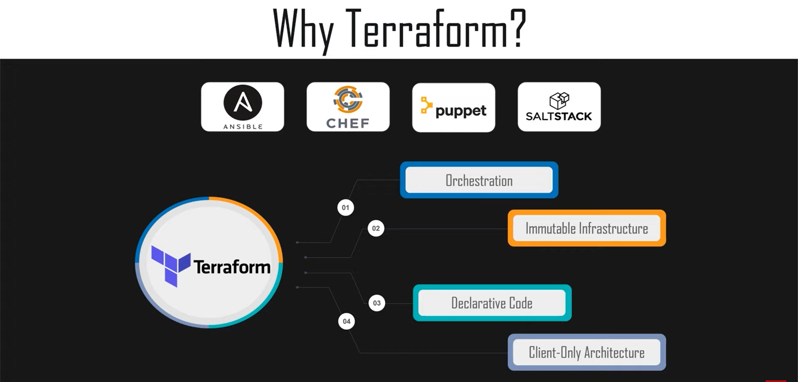

Slide 25
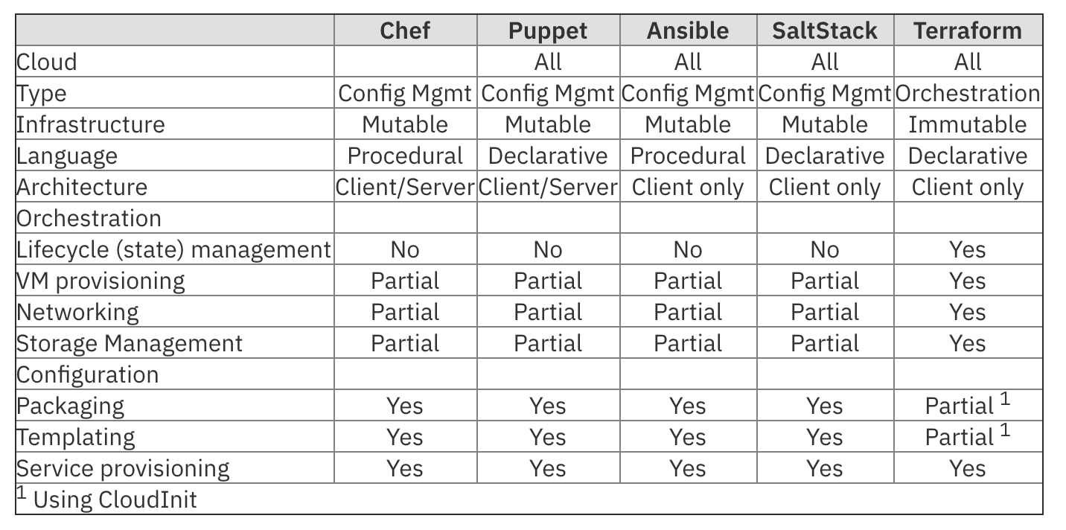
IaC Tools

Slide 26
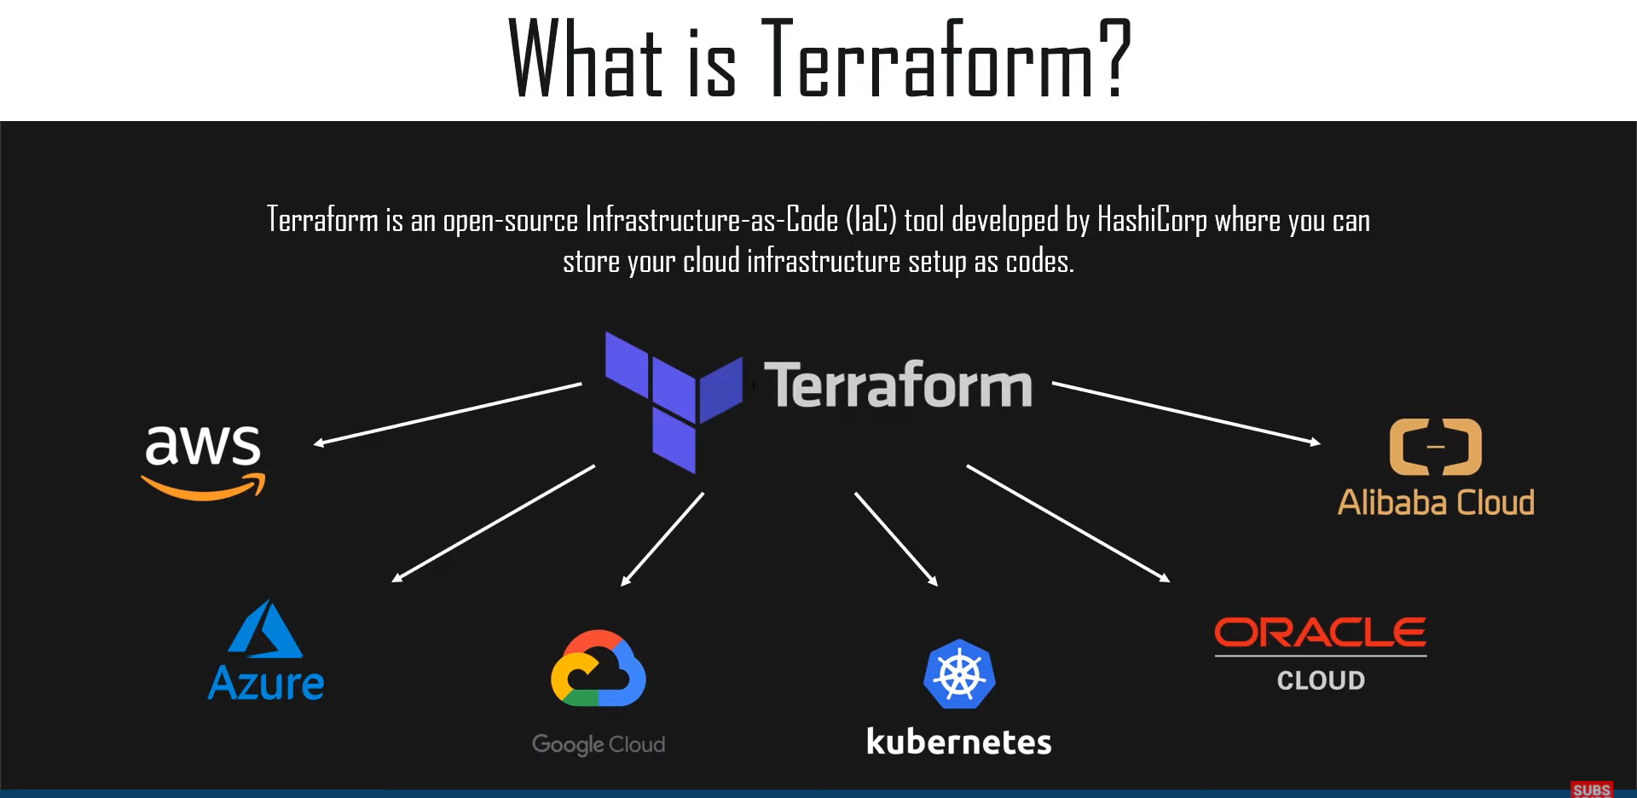

Slide 27
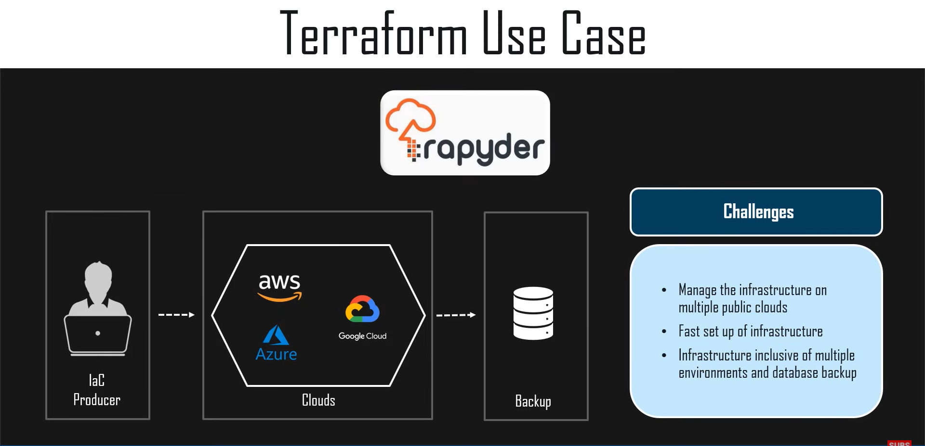

Slide 28
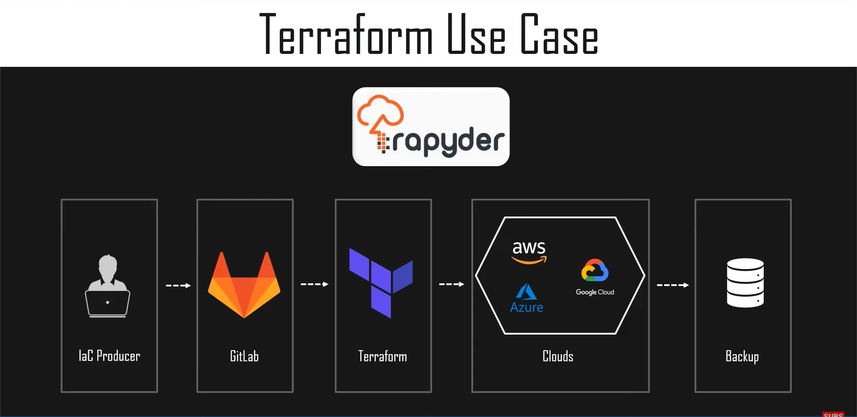

Slide 29
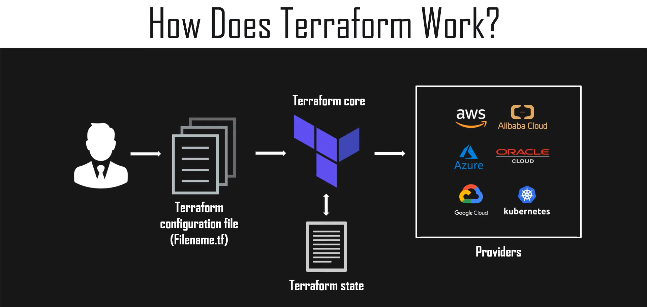

Slide 30
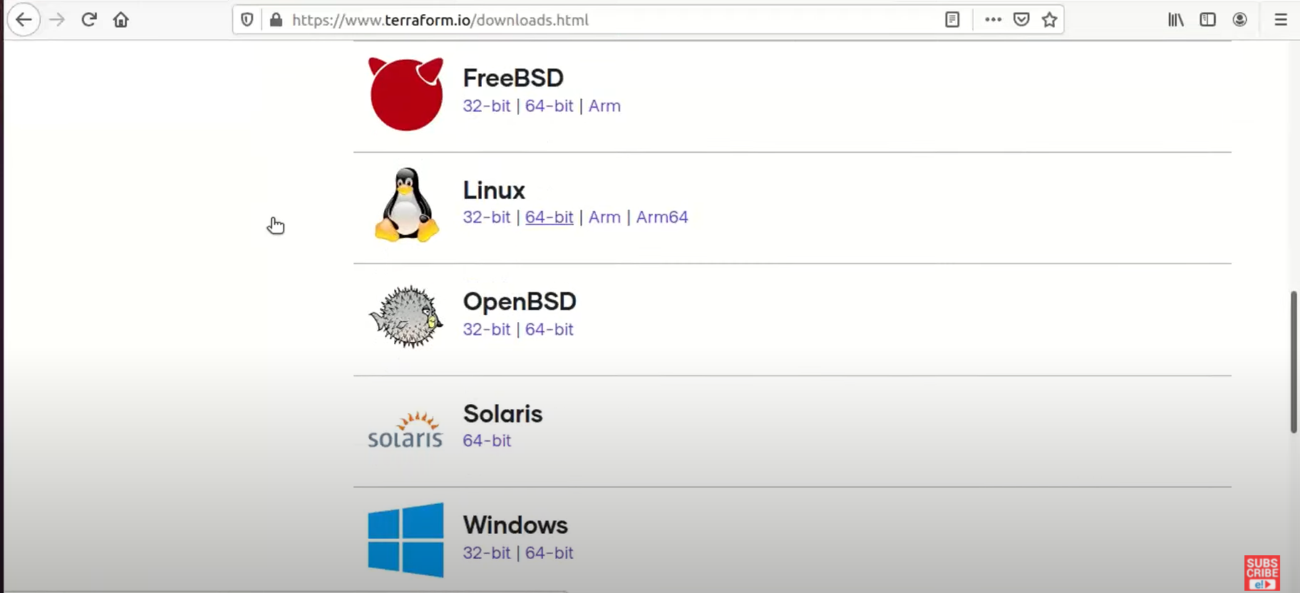
Terraform Installation -Hashicorp

Slide 31
Terraform
If you are in a Ops or DevOps role, you’ll want to automate your infra
Terraform is a great tool to do this:
You can automate your infrastructure by using Infrastructure as Code (IaaS)
Every terraform run will be a repeatable, reliable process
Terraform can provision any of the main cloud providers, including AWS
You can keep a history of your changes made to your infrastructure
Collaborate within a team to build infrastructure

Slide 32
What is Terraform

Slide 33
Terraform
Infrastructure as code
Automation of your infrastructure
Keep your infrastructure in a certain state (compliant)
e.g. 2 web instances with 2 volumes, and 1 load balancer
Make your infrastructure auditable
You can keep your infrastructure change history in a version control
system like GIT

Slide 34
Terraform
Ansible, Chef, Puppet, Saltstack have a focus on automating the
installation and configuration of software
Keeping the machines in compliance, in a certain state
Terraform can automate provisioning of the infrastructure itself
eg. Using the AWS, DigitalOcean, Azure API
Works well with automation software like ansible to install software after the infrastructure is provisioned

Slide 35
Demo
Installing terraform

Slide 36
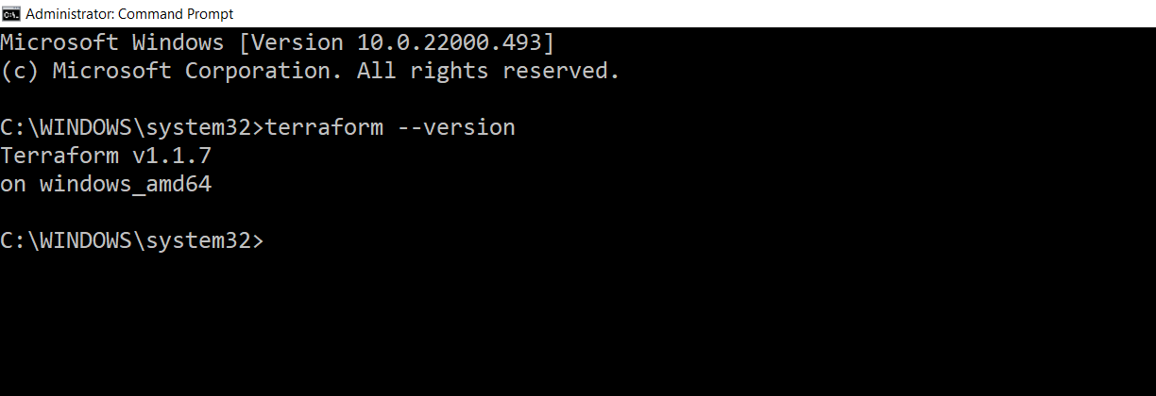
Terraform version

Slide 37
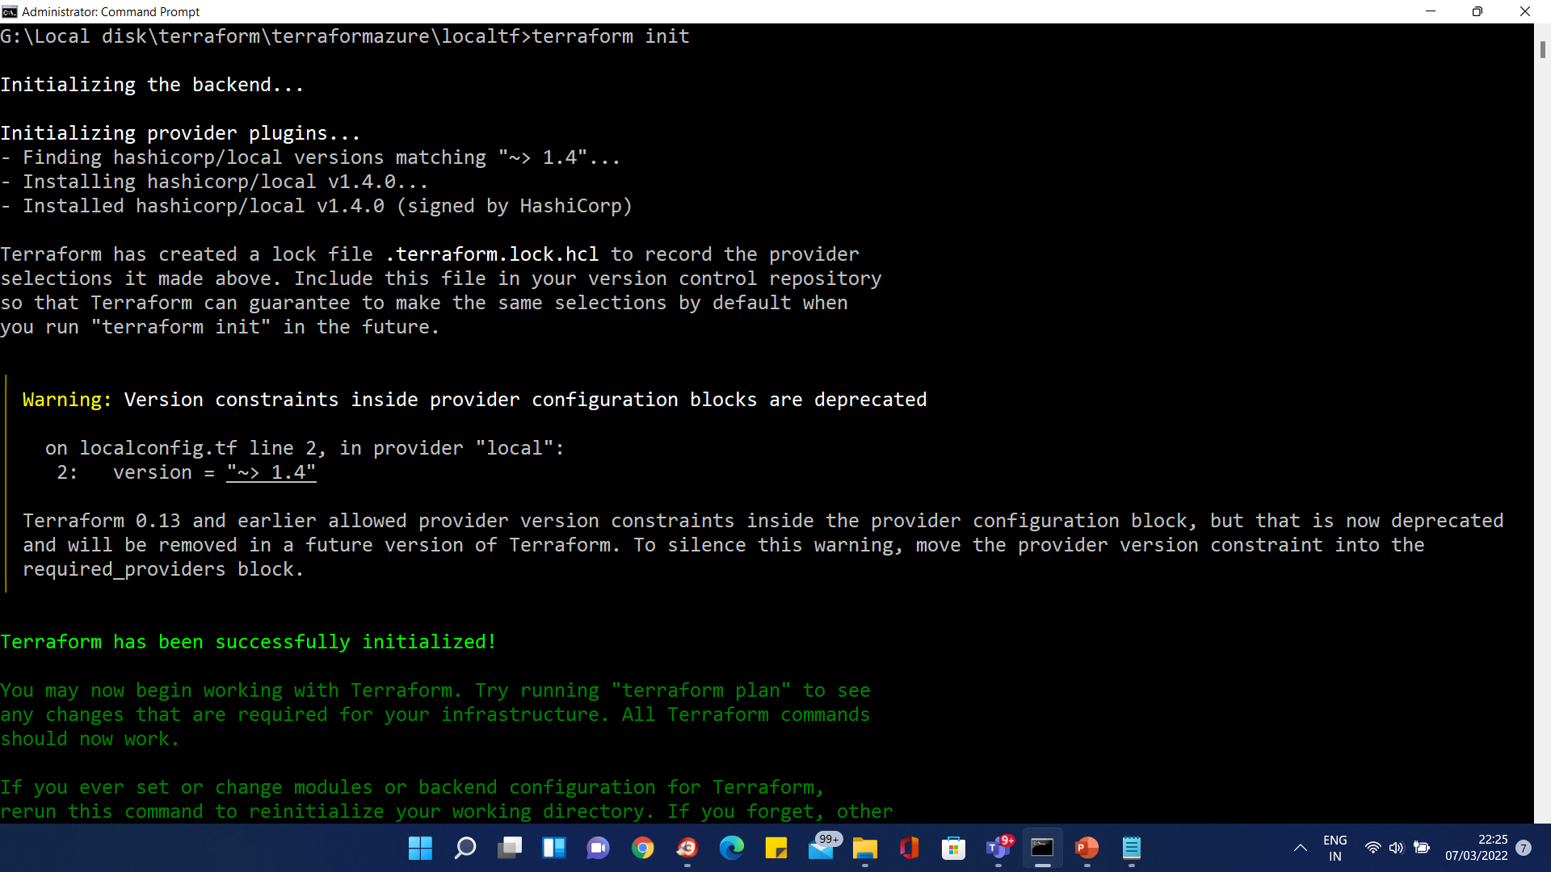
Terraform version

Slide 38
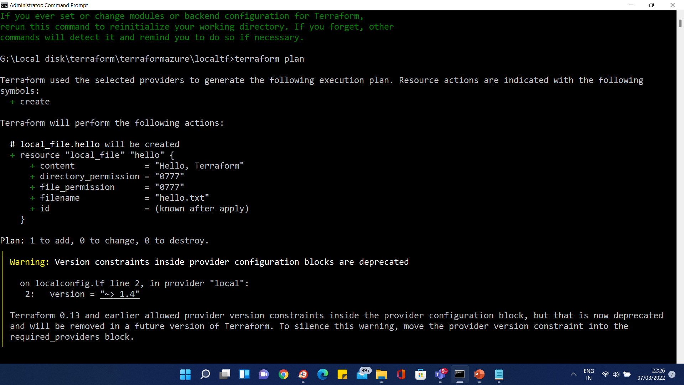
Terraform version

Slide 39
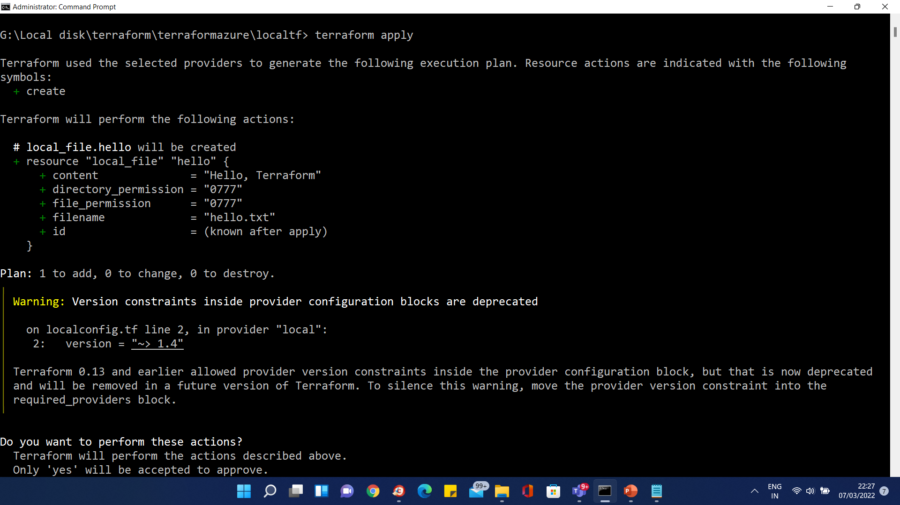
Terraform version

Slide 40
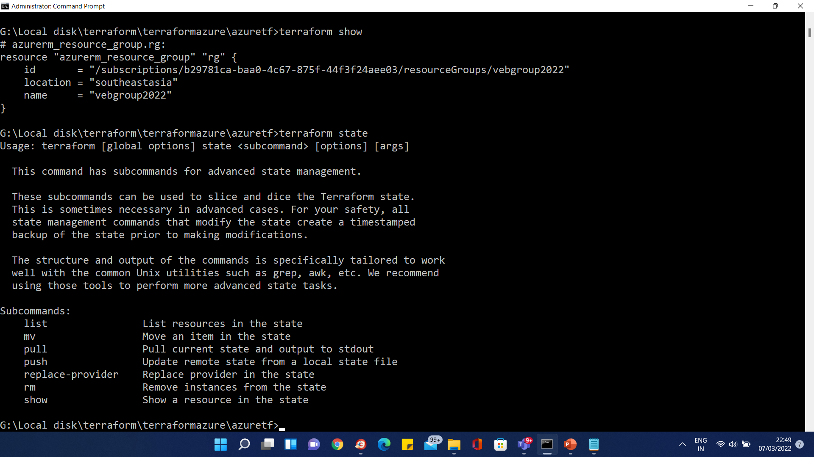
Terraform version

Slide 41
Demo
Installing terraform on Windows + Creating SSH keys using puttyGen

Slide 42
Demo
Installing terraform using Vagrant

Slide 43
Terraform HCL
(HashiCorp Configuration Language) Understanding the terraform syntax

Slide 44
First steps in terraform
Spinning up instance on AWS

Slide 45
Terraform
Spinning up an instance on AWS
Open AWS Account
Create IAM admin user
Create terraform file to spin up t2.micro instance
Run terraform apply

Slide 46

Terraform
Testing what infrastructure would be built based on our terraform files:
$ terraform plan
...
+ aws_instance.example
ami: "ami-0d729a60" availability_zone: "<computed>" ebs_block_device.#: "<computed>" ephemeral_block_device.#: "<computed>" instance_state: "<computed>" instance_type: "t2.micro"
key_name: "<computed>"
placement_group: "<computed>" private_dns: "<computed>" private_ip: "<computed>" public_dns: "<computed>" public_ip: "<computed>" root_block_device.#: "<computed>" security_groups.#: "<computed>" source_dest_check: "true" subnet_id: "<computed>"
tenancy: "<computed>"
vpc_security_group_ids.#: "<computed>"

Slide 47

Terraform
Then use terraform apply to execute the changes:
$ terraform apply
aws_instance.example: Creating...
ami: "" => "ami-0d729a60" instance_type: "" => "t2.micro" [...]
aws_instance.example: Creation complete
Apply complete! Resources: 1 added, 0 changed, 0 destroyed.

Slide 48

Terraform
Keeping the changes in an out file
$ terraform plan -out changes.terraform
...
Then only apply those changes to the infrastructure
$ terraform apply changes.terraform
...
$ rm changes.terraform

Slide 49
Terraform
Afterwards the infrastructure can be destroyed again:
$ terraform destroy
aws_instance.example: Destroying...
Apply complete! Resources: 0 added, 0 changed, 1 destroyed.
...
•
Now the instances are terminated and you stop paying AWS for the EC2 instances
•
Be very careful with this command on a production environment!

Slide 50
First steps in terraform
Summary

Slide 51
Variables in terraform

Slide 52
Terraform
Everything in one file is not great
Use variables to hide secrets
You don’t want the AWS credentials in your git repository
Use variables for elements that might change
AMIs are different per region
Use variables to make it yourself easier to reuse terraform files

Slide 53

Terraform
instance.tf
provider "aws" {
access_key = "ACCESS_KEY_HERE" secret_key = "SECRET_KEY_HERE" region = "us-east-1"
}
resource "aws_instance" "example" { ami = "ami-0d729a60" instance_type = "t2.micro"
}

Slide 54


Terraform
provider.tf
vars.tf
provider "aws" {
access_key = "${var.AWS_ACCESS_KEY}" secret_key = "${var.AWS_SECRET_KEY}" region = "${var.AWS_REGION}"
}
variable "AWS_ACCESS_KEY" {} variable "AWS_SECRET_KEY" {} variable "AWS_REGION" { default = "eu-west-1"
}
terraform.tfvars
instance.tf
AWS_ACCESS_KEY = "" AWS_SECRET_KEY = "" AWS_REGION = ""
resource "aws_instance" "example" { ami = "ami-0d729a60" instance_type = "t2.micro"
}

Slide 55

Terraform
provider.tf
vars.tf
provider "aws" {
access_key = "${var.AWS_ACCESS_KEY}" secret_key = "${var.AWS_SECRET_KEY}" region = "${var.AWS_REGION}"
}
variable "AWS_ACCESS_KEY" {} variable "AWS_SECRET_KEY" {} variable "AWS_REGION" { default = "eu-west-1"
}
variable "AMIS" { type = "map" default = {
us-east-1 = "ami-13be557e"
us-west-2 = "ami-06b94666" eu-west-1 = "ami-0d729a60"
}
}
instance.tf
resource "aws_instance" "example" {
ami = "${lookup(var.AMIS, var.AWS_REGION)}" instance_type = "t2.micro"
}
https://cloud-images.ubuntu.com/locator/ec2/

Slide 56
Demo
Using variables

Slide 57
Terraform Variable Types

Slide 58
Terraform Variable Types
Terraform variables were completely reworked for the terraform 0.12 release
You can now have more control over the variables, and have for and for-each loops, which where not possible with earlier versions
You don’t have to specify the type in variables, but it’s recommended

Slide 59

Terraform Variable Types
Terraform’s simple variable types
String
Number
Bool
variable "a-string" { type = string
}
variable "this-is-a-number" { type = number
}
variable "true-or-false" { type = bool
}

Slide 60
Terraform Variable Types
Terraform’s complex types
List(type)
Set(type)
Map(type)
Object({<ATTR NAME> = <TYPE>, ... })
Tuple([<TYPE>, ...])

Slide 61
Terraform Variable Types
List & Map we already covered during a previous demo
List: [0,1,5,2]
Map: {"key" = "value"}
A list is always ordered, it’ll always return 0,1,5,2 and not 5,1,2,0
A "set" is like a list, but it doesn’t keep the order you put it in, and can only contain unique values
A list that has [5, 1, 1, 2] becomes [1,2,5] in a set (when you output it, terraform will sort it)

Slide 62

Terraform Variable Types
An object is like a map, but each element can have a different type
For example:
{
firstname = "John" housenumber = 10
}

Slide 63

Terraform Variable Types
An tuple is like a list, but each element can have a different type
For example:
[0, "string", false]

Slide 64
Terraform Variable Types
The most common types are list and map, the other ones are only used sporadically
The ones you should remember are the simple variable types string, number, bool and the list & map

Slide 65

Terraform Variable Types
You can also let terraform decide on the type:
variable "a-string" { default = "this is a string"
}
variable "this-is-a-list" { default = [ "list of", "strings" ]
}

Slide 66
Provisioning software

Slide 67
Terraform
There are 2 ways to provision software on your instances
You can build your own custom AMI and bundle your software with the image
Packer is a great tool to do this
Another way is to boot standardized AMIs, and then install the software on it you need
Using file uploads
Using remote exec
Using automation tools like chef, puppet, ansible

Slide 68
Terraform
Current state for terraform with automation (Q4 2016):
Chef is integrated within terraform, you can add chef statements
You can run puppet agent using remote-exec
For ansible, you can first run terraform, and output the IP addresses, then run ansible-playbook on those hosts
This can be automated in a workflow script
There are 3rd party initiatives integrating Ansible with terraform

Slide 69
File uploads
instance.tf
resource "aws_instance" "example" {
ami = "${lookup(var.AMIS, var.AWS_REGION)}" instance_type = "t2.micro"
provisioner "file" { source = "app.conf"
destination = "/etc/myapp.conf"
}
}
File uploads is an easy way to upload a file or a script
Can be used in conjunction with remote-exec to execute a script
The provisioner may use SSH (Linux hosts) or WinRM (on windows hosts)

Slide 70

File uploads
To override the SSH defaults, you can use "connection": instance.tf
resource "aws_instance" "example" {
ami = "${lookup(var.AMIS, var.AWS_REGION)}" instance_type = "t2.micro"
provisioner "file" { source = "script.sh"
destination = "/opt/script.sh"
connection {
user = "${var.instance_username}" password = "${var.instance_password}"
}
}
}
When spinning up instances on AWS, ec2-user is the default user for Amazon Linux and ubuntu for Ubuntu Linux

Slide 71

File uploads
Typically on AWS, you’ll use SSH keypairs: instance.tf
resource "aws_key_pair" "mykey" { key_name = "mykey"
public_key = "ssh-rsa my-public-key"
}
resource "aws_instance" "example" {
ami = "${lookup(var.AMIS, var.AWS_REGION)}" instance_type = "t2.micro"
key_name = "${aws_key_pair.mykey.key_name}"
provisioner "file" { source = "script.sh"
destination = "/opt/script.sh"
connection {
user = "${var.instance_username}"
private_key = "${file(${var.path_to_private_key})}"
}
}
}

Slide 72

Terraform
After you uploaded a script, you’ll want to execute it
You can execute a script using remote-exec:
resource "aws_instance" "example" {
ami = "${lookup(var.AMIS, var.AWS_REGION)}" instance_type = "t2.micro"
provisioner "file" { source = "script.sh"
destination = "/opt/script.sh"
}
provisioner "remote-exec" { inline = [
"chmod +x /opt/script.sh",
"/opt/script.sh arguments"
]
}
}

Slide 73
Demo
Provisioning with script

Slide 74
Demo
Provisioning Windows Server

Slide 75
Output

Slide 76
Terraform
Terraform keeps attributes of all the resources you create
eg. the aws_instance resource has the attribute public_ip
Those attributes can be queried and outputted
This can be useful just to output valuable information or to feed information to external software

Slide 77
Terraform
Use "output" to display the public IP address of an AWS resource:
resource "aws_instance" "example" {
ami = "${lookup(var.AMIS, var.AWS_REGION)}" instance_type = "t2.micro"
}
output "ip" {
value = "${aws_instance.example.public_ip}"
}
You can refer to any attribute by specifying the following elements in your variable:
The resource type: aws_instance
The resource name: example
The attribute name: public_ip

Slide 78
Terraform
You can also use the attributes in a script:
resource "aws_instance" "example" {
ami = "${lookup(var.AMIS, var.AWS_REGION)}" instance_type = "t2.micro"
provisioner "local-exec" {
command = "echo ${aws_instance.example.private_ip} >> private_ips.txt"
}
}
Useful for instance to start automation scripts after infrastructure provisioning
You can populate the IP addresses in an ansible host file
Or another possibility: execute a script (with attributes as argument) which will take care of a
mapping of resource name and the IP address

Slide 79
Demo
outputting

Slide 80
Terraform state

Slide 81
Terraform
Terraform keeps the remote state of the infrastructure
It stores it in a file called terraform.tfstate
There is also a backup of the previous state in terraform.tfstate.backup
When you execute terraform apply, a new terraform.tfstate and backup is written
This is how terraform keeps track of the remote state
If the remote state changes and you hit terraform apply again, terraform will make changes to meet the correct remote state again
e.g. you terminate an instance that is managed by terraform, after terraform apply it will be started again

Slide 82
Terraform
You can keep the terraform.tfstate in version control
e.g. git
It gives you a history of your terraform.tfstate file (which is just a big JSON file)
It allows you to collaborate with other team members
Unfortunately you can get conflicts when 2 people work at the same time
Local state works well in the beginning, but when you project becomes bigger, you might want to store your state remote

Slide 83
Terraform
The terraform state can be saved remote, using the backend
functionality in terraform
The default is a local backend (the local terraform state file)
Other backens include:
s3 (with a locking mechanism using dynamoDB)
consul (with locking)
terraform enterprise (the commercial solution)

Slide 84
Terraform
Using the backend functionality has definitely benefits:
Working in a team: it allows for collaboration, the remote state will always be available for the whole team
The state file is not stored locally. Possible sensitive information is now only stored in the remote state
Some backends will enable remote operations. The terraform apply will then run completely remote. These are called the enhanced backends (https://www.terraform.io/docs/backends/types/index.html)

Slide 85
Terraform
There are 2 steps to configure a remote state:
Add the backend code to a .tf file
Run the initialization process

Slide 86

Terraform
To configure a consul remote store, you can add a file backend.tf with the following contents:
terraform { backend "consul" {
address = "demo.consul.io" # hostname of consul cluster
path = "terraform/myproject"
}
}

Slide 87


Terraform
You can also store your state in S3:
terraform { backend "s3" {
bucket = "mybucket"
key = "terraform/myproject" region = "eu-west-1"
}
}
•
When using an S3 remote state, it’s best to configure the AWS credentials:
$ aws configure
AWS Access Key ID []: AWS-key
AWS Secret Access Key []: AWS_secret_key Default region name []: eu-west-1
Default output format [None]:

Slide 88

Terraform
Next step, terraform init:
$ terraform init Initializing the backend... region
The region of the S3 bucket.
Enter a value: eu-west-1
Successfully configured the backend "s3"! Terraform will automatically use this backend unless the backend configuration changes.
Terraform has been successfully initialized!
You may now begin working with Terraform. Try running "terraform plan" to see any changes that are required for your infrastructure. All Terraform commands should now work.
If you ever set or change modules or backend configuration for Terraform, rerun this command to reinitialize your environment. If you forget, other commands will detect it and remind you to do so if necessary.

Slide 89
Terraform
Using a remote store for the terraform state will ensure that you always have the latest version of the state
It avoids having to commit and push the terraform.tfstate to version control
Terraform remote stores don’t always support locking
The documentation always mentions if locking is available for a remote store
S3 and consul support it

Slide 90

Terraform
You can also specify a (read-only) remote store directly in the .tf file
data "terraform_remote_state" "aws-state" { backend = "s3"
config {
bucket = "terraform-state" key = "terraform.tfstate"
access_key = "${var.AWS_ACCESS_KEY}"
secret_key = "${var.AWS_SECRET_KEY}" region = "${var.AWS_REGION}"
}
}
This is only useful as a read only feed from your remote file
It’s a datasource (which I’ll cover later)
Useful to generate outputs

Slide 91
Demo
Terraform state with S3

Slide 92
Datasources

Slide 93
Datasources
For certain providers (like AWS), terraform provides datasources
Datasources provide you with dynamic information
A lot of data is available by AWS in a structured format using their API
Terraform also exposes this information using data sources
Examples:
List of AMIs
List of availability Zones

Slide 94
Datasources
Another great example is the datasource that gives you all IP addresses in use by AWS
This is great if you want to filter traffic based on an AWS region
e.g. allow all traffic from amazon instances in Europe
Filtering traffic in AWS can be done using security groups
Incoming and outgoing traffic can be filtered by protocol, IP range, and port
Similar to iptables (linux) or a firewall appliance

Slide 95

Datasources
data "aws_ip_ranges" "european_ec2" { regions = [ "eu-west-1", "eu-central-1" ] services = [ "ec2" ]
}
resource "aws_security_group" "from_europe" { name = "from_europe"
ingress { from_port = "443"
to_port = "443"
protocol = "tcp"
cidr_blocks = [ "${data.aws_ip_ranges.european_ec2.cidr_blocks}" ]
}
tags {
CreateDate = "${data.aws_ip_ranges.european_ec2.create_date}" SyncToken = "${data.aws_ip_ranges.european_ec2.sync_token}"
}
}
Example from https://www.terraform.io/docs/providers/aws/d/ip_ranges.html

Slide 96
Demo
Datasources

Slide 97
Template provider

Slide 98
Template provider
The template provider can help creating customized configuration files
You can build templates based on variables from terraform resource attributes (e.g. a public IP address)
The result is a string that can be used as a variable in terraform
The string contains a template
e.g. a configuration file
Can be used to create generic templates or cloud init configs

Slide 99
Template provider
In AWS, you can pass commands that need to be executed when the instance starts for the first time
In AWS this is called "user-data"
If you want to pass user-data that depends on other information in terraform (e.g. IP addresses), you can use the provider template
There’s a separate section on userdata in this course

Slide 100

Template provider
First you create a template file:
#!/bin/bash
echo "database-ip = ${myip}" >> /etc/myapp.config
•
Then you create a template_file resource that will read the template file and replace $
{myip} with the IP address of an AWS instance created by terraform
data "template_file" "my-template" { template = "${file("templates/init.tpl")}"
vars {
myip = "${aws_instance.database1.private_ip}"
}
}

Slide 101
Template provider
Then you can use the my-template resource when creating a new instance
# Create a web server
resource "aws_instance" "web" { # ...
user_data = "${data.template_file.my-template.rendered}"
}
•
When terraform runs, it will see that it first needs to spin up the database1 instance, then generate the template, and only then spin up the web instance
•
The web instance will have the template injected in the user_data, and when it launches, the user-data will create a file /etc/myapp.config with the IP address of the database

Slide 102
Other providers

Slide 103
Other providers
Terraform is a tool to create and manage infrastructure resources
Terraform has many providers to choose from
AWS is the most popular one, and will be the one I’ll discuss most in this course
Potentially any company that opens up an API, can be used as a terraform provider

Slide 104
Other providers
Some other examples of Cloud providers supported by terraform are:
Google Cloud
Azure
Heroku
DigitalOcean
And on-premise / private cloud:
VMware vCloud / vSphere / OpenStack

Slide 105
Other providers
It’s not only limited to cloud providers:
Datadog - monitoring
GitHub - version control
Mailgun - emailing (SMTP)
DNSSimple / DNSMadeEAsy / UltraDNS - DNS hosting
The full list can be found at https://www.terraform.io/docs/providers/ index.html

Slide 106

Other providers
The terraform resources for other providers are very similar
A digitalOcean example:
variable "do_token" {} provider "digitalocean" {
token = "${var.do_token}"
}
resource "digitalocean_droplet" "mydroplet" { image = "ubuntu-14-04-x64"
name = "web-1"
region = "nyc2" size = "512mb"
}

Slide 107
Modules

Slide 108
Modules
You can use modules to make your terraform more organized
Use third party modules
Modules from github
Reuse parts of your code
e.g. to set up network in AWS - the Virtual Private Network (VPC)

Slide 109

Modules
Use a module from git
module "module-example" {
source = "github.com/wardviaene/terraform-module-example"
}
•
Use a module from a local folder
module "module-example" { source = "./module-example"
}

Slide 110

Modules
Pass arguments to the module
module "module-example" { source = "./module-example" region = "us-west-1"
ip-range = "10.0.0.0/8"
cluster-size = "3"
}

Slide 111


Modules
Inside the module folder, you just have again terraform files:
module-example/vars.tf module-example/cluster.tf
variable "region" {} # the input parameters variable "ip-range" {}
variable "cluster-size" {}
# vars can be used here
resource "aws_instance" "instance-1" { … } resource "aws_instance" "instance-2" { … } resource "aws_instance" "instance-3" { … }
module-example/output.tf
output "aws-cluster" {
value = "${aws_instance.instance-1.public_ip},${aws_instance.instance-2.public_ip},${aws_instance.instance-2.public_ip}"
}

Slide 112
Modules
Use the output from the module in the main part of your code:
output "some-output" {
value = "${module.module-example.aws-cluster}"
}
•
I’m just using the output resource here, but you can use the variables anywhere in the terraform code

Slide 113
Demo
Modules

Slide 114
Terraform Command Overview

Slide 115
Terraform Command Overview
Terraform is very much focussed on the resource definitions
It has a limited toolset available to modify, import, create these resource definitions
Still, every new release there are new features coming out to make it easier to handle your resources
For example, today (Q4 - 2016), there’s still no good tool to import your non- terraform maintained infrastructure and create the definitions for you
There is an external tool called terraforming that you can use for now, but it’ll take you quite some time to convert your current infrastructure to managed terraform infrastructure (https://github.com/dtan4/terraforming)

Slide 116
Terraform Command Overview
Command Description
terraform apply Applies state
destroy Destroys all terraform managed state (use with caution)
fmt Rewrite terraform configuration files to a canonical format and style
get Download and update modules
graph Create a visual representation of a configuration or execution plan
import [options] ADDRESS ID
Import will try and find the infrastructure resource identified with ID and import the state into terraform.tfstate with resource id ADDRESS

Slide 117
Terraform Command Overview
Command Description
output [options] [NAME]
Output any of your resources. Using NAME will only output a specific resource
plan terraform plan, show the changes to be made to the infrastructure
push
Push changes to Atlas, Hashicorp’s Enterprise tool that can automatically run terraform from a centralized server
refresh
Refresh the remote state. Can identify differences between state file and remote state
remote Configure remote state storage
show Show human readable output from a state or a plan

Slide 118
Terraform Command Overview
Command Description
Use this command for advanced state management, e.g. Rename a resource with terraform state mv aws_instance.example aws_instance.production
state
Manually mark a resource as tainted, meaning it will be destructed and recreated at the next apply
taint
validate validate your terraform syntax
untaint undo a taint

Slide 119
Demo
Command overview

Slide 120
Terraform with AWS

Slide 121
Creating a VPC

Slide 122
Creating the VPC
On Amazon AWS, you have a default VPC (Virtual Private Network) created for you by AWS to launch instances in
Up until now we used this default VPC
VPC isolates the instances on a network level
It’s like your own private network in the cloud
Best practice is to always launch your instances in a VPC
the default VPC
or one you create yourself (managed by terraform)
Edward Viaene - Copyright 2016

Slide 123
Creating the VPC
There’s also EC2-Classic, which is basically one big network where all AWS customers could launch their instances in
For smaller to medium setups, one VPC (per region) will be suitable for your needs
An instance launched in one VPC can never communicate with an instance in an other VPC using their private IP addresses
They could communicate still, but using their public IP (not recommended)
You could also link 2 VPCs, called peering
Edward Viaene - Copyright 2016

Slide 124
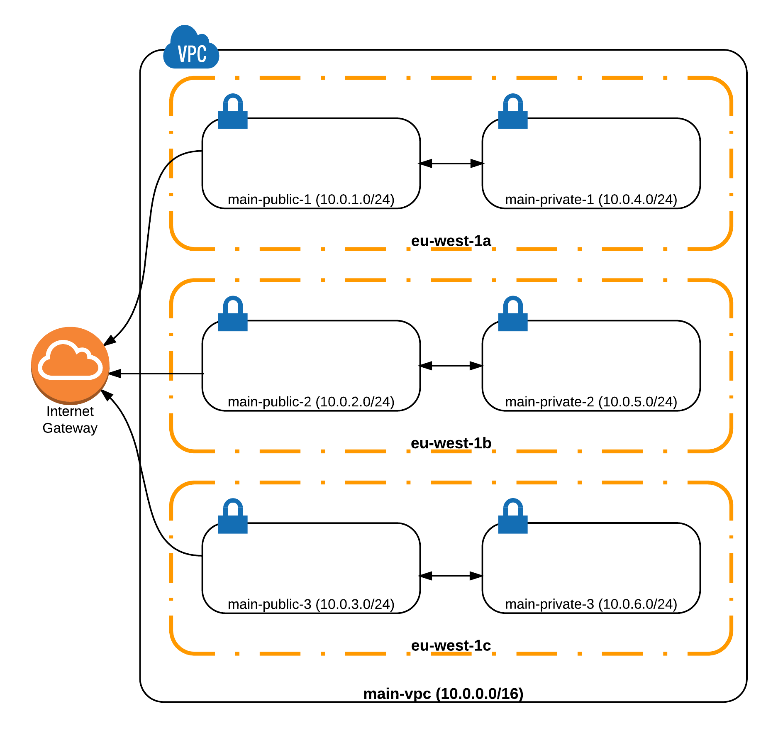
Creating the VPC
•
On Amazon AWS, you start by creating your own Virtual Private Network to deploy your instances (servers) / databases in
•
This VPC uses the 10.0.0.0/16 addressing space, allowing you to use the IP addresses that start with "10.0.", like this: 10.0.x.x.
•
This VPC covers the eu-west-1 region, which is an Amazon AWS Region in Ireland.
Edward Viaene - Copyright 2016

Slide 125
Private Subnets
Range | From | to
10.0.0.0/8 | 10.0.0.0 | 10.255.255.255
172.16.0.0/12 | 172.16.0.0 | 172.31.255.255.
192.168.0.0/16 | 192.168.0.0 | 192.168.255.255
Edward Viaene - Copyright 2016

Slide 126
Subnet masks
Range | Network mask | Total addresses | Description | Examples
10.0.0.0/8 | 255.0.0.0 | 16,777,214 | Full 10.x.x.x range | 10.0.0.1, 10.100.200.20
10.0.0.0/16 | 255.255.0.0 | 65,536 | What we used for our VPC | 10.0.5.1, 10.0.20.2, 10.0.100.3
10.1.0.0/16 | 255.255.0.0 | 65,536 | What we can use for another VPC | 10.1.5.1, 10.1.20.2, 10.1.100.3
10.0.0.0/24 | 255.255.255.0 | 256 | All addresses within from 10.0.0.0-10.0.0.255 | 10.0.0.1, 10.0.0.2, 10.0.0.3
10.0.1.0/24 | 255.255.255.0 | 256 | All addresses within from 10.0.1.0-10.0.1.255 | 10.0.1.1, 10.0.1.2, 10.0.1.3
10.0.0.5/32 | 255.255.255.255 | 1 | Single host | 10.0.0.5
Edward Viaene - Copyright 2016

Slide 127
Creating the VPC
•
Every availability zone has its own
public and private subnet
•
Instances started in subnet main- public-3 will have IP address 10.0.3.x, and will be launched in the eu-west-1c availability zone (Amazon calls 1 datacenter an availability zone)
•
An instance launched in main- private-1 will have an IP address
10.0.4.x and will reside in Amazon’s eu-west-1a Availability Zone (AZ)
Edward Viaene - Copyright 2016

Slide 128
Creating the VPC
•
All the public subnets are connected to an Internet Gateway. These instances will also have a public IP address, allowing them to be reachable from the internet
•
Instances launched in the private subnets don’t get a public IP address, so they will not be reachable from the internet
•
Instances from main-public can reach instances from main-private, because they’re all in the same VPC. This of course if you set the firewall to allow traffic from one to another.
Edward Viaene - Copyright 2016

Slide 129
Creating the VPC
•
Typically, you use the public subnets for internet-facing services/applications
•
Databases, caching services, and backends all go into the private subnets
•
If you use a Load Balancer (LB), you will typically put the LB in the public subnets and the instances serving an application in the private subnets.
Edward Viaene - Copyright 2016

Slide 130
VPC demo

Slide 131
Spinning up instances
EC2, EBS

Slide 132
EC2 instance
Spinning up an EC2 instance is very straightforward, let’s recap
provider.tf vars.tf
provider "aws" {
access_key = "${var.AWS_ACCESS_KEY}" secret_key = "${var.AWS_SECRET_KEY}" region = "${var.AWS_REGION}"
}
variable "AWS_ACCESS_KEY" {} variable "AWS_SECRET_KEY" {} variable "AWS_REGION" { default = "eu-west-1"
}
variable "AMIS" { type = "map" default = {
us-east-1 = "ami-13be557e"
us-west-2 = "ami-06b94666" eu-west 1 = "ami-844e0bf7"
}
}
instance.tf
resource "aws_instance" "example" {
ami = "${lookup(var.AMIS, var.AWS_REGION)}" instance_type = "t2.micro"
}

Slide 133

EC2 instance
Now we want to launch the instance in our newly created VPC
With security groups
Using a keypair that will be uploaded by terraform
instance.tf
resource "aws_instance" "example" {
ami = "${lookup(var.AMIS, var.AWS_REGION)}" instance_type = "t2.micro"
# the VPC subnet
subnet_id = "${aws_subnet.main-public-1.id}"
# the security group
vpc_security_group_ids = ["${aws_security_group.allow-ssh.id}"]
# the public SSH key
key_name = "${aws_key_pair.mykeypair.key_name}"
}

Slide 134
EC2 instance
We need a new security group for this EC2 instance
A security group is a just like a firewall, managed by AWS
You specify ingress (incoming) and egress (outgoing) traffic rules
If you only want to access SSH (port 22), then you could create a security group that:
Allows ingress port 22 on IP address range 0.0.0.0/0 (all IPs)
It’s best practice to only allow your work/home/office IP
Allow all outgoing traffic from the instance to 0.0.0.0/0 (all IPs, so everywhere)

Slide 135

EC2 instance
securitygroup.tf
resource "aws_security_group" "allow-ssh" { vpc_id = "${aws_vpc.main.id}"
name = "allow-ssh"
description = "security group that allows ssh and all egress traffic" egress {
from_port = 0
to_port = 0
protocol = "-1"
cidr_blocks = ["0.0.0.0/0"]
}
ingress { from_port = 22
to_port = 22
protocol = "-1"
cidr_blocks = ["0.0.0.0/0"]
}
tags {
Name = "allow-ssh"
}
}

Slide 136

EC2 instance
To be able to log in, the last step is to make sure AWS installs our public key pair on the instance
Our EC2 instance already refers to a aws_key_pair.mykeypair.key_name, you just need to declare it in terraform:
keypairs.tf
resource "aws_key_pair" "mykeypair" { key_name = "mykeypair"
public_key = "${file("keys/mykeypair.pub")}"
}
The keys/mykeypair.pub will be uploaded to AWS and will allow an instance to be launched with this public key installed on it
You never upload your private key! You use your private key to login to the instance

Slide 137
AWS Instance demo

Slide 138
Spinning up instances
Block storage (EBS)

Slide 139
EC2 instance
•
The t2.micro instance with this particular AMI automatically adds 8 GB of EBS storage (=
Elastic Block Storage)
•
Some instance types have local storage on the instance itself
This is called ephemeral storage
This type of storage is always lost when the instance terminates
The 8 GB EBS root volume storage that comes with the instance is also set to be automatically removed when the instance is terminated
You could still instruct AWS not to do so, but that would be counter-intuitive (anti- pattern)
•
•
In most cases the 8GB for the OS (root block device) suffices

Slide 140
EC2 instance
In our next example I’m adding an extra EBS storage volume
Extra volumes can be used for the log files, any real data that is put on the instance
That data will be persisted until you instruct AWS to remove it
EBS storage can be added using a terraform resource and then attached to our instance

Slide 141

EC2 instance
instance.tf
resource "aws_instance" "example" {
…
}
resource "aws_ebs_volume" "ebs-volume-1" {
availability_zone = "eu-west-1a" size = 20
type = "gp2" # General Purpose storage, can also be standard or io1 or st1
tags {
Name = "extra volume data"
}
}
resource "aws_volume_attachment" "ebs-volume-1-attachment" { device_name = "/dev/xvdh"
volume_id = "${aws_ebs_volume.ebs-volume-1.id}"
instance_id = "${aws_instance.example.id}"
}

Slide 142

EC2 instance
In the previous example we added an extra volume
The root volume of 8 GB still exists
If you want to increase the storage or type of the root volume, you can use
root_block_device within the aws_instance resource
resource "aws_instance" "example" {
… root_block_device { volume_size = 16
volume_type = "gp2"
delete_on_termination = true # whether to delete the root block device when the instance gets terminated or not
}
}

Slide 143
EBS demo

Slide 144
Userdata

Slide 145
Userdata
Userdata in AWS can be used to do any customization at launch:
You can install extra software
Prepare the instance to join a cluster
e.g. consul cluster, ECS cluster (docker orchestration)
Execute commands / scripts
Mount volumes
Userdata is only executed at the creation of the instance, not when the instance reboots

Slide 146
Userdata
Terraform allows you to add userdata to the aws_instance resource
Just as a string (for simple commands)
Using templates (for more complex instructions)

Slide 147

Userdata
This is an example of userdata just using a string
It’ll install an OpenVPN application server at boot time instance.tf
resource "aws_instance" "example" {
ami = "${lookup(var.AMIS, var.AWS_REGION)}" instance_type = "t2.micro"
# the VPC subnet
subnet_id = "${aws_subnet.main-public-1.id}" # the security group
vpc_security_group_ids = ["${aws_security_group.allow-ssh.id}"]
# the public SSH key
key_name = "${aws_key_pair.mykeypair.key_name}"
# userdata
user_data = "#!/bin/bash\nwget http://swupdate.openvpn.org/as/openvpn-as-2.1.2-Ubuntu14.amd_64.deb\ndpkg -i openvpn- as-2.1.2-Ubuntu14.amd_64.deb"
}

Slide 148
Userdata
Another better example is to use the template system of terraform:
instance.tf
resource "aws_instance" "example" {
ami = "${lookup(var.AMIS, var.AWS_REGION)}" instance_type = "t2.micro"
# the VPC subnet
subnet_id = "${aws_subnet.main-public-1.id}" # the security group
vpc_security_group_ids = ["${aws_security_group.allow-ssh.id}"]
# the public SSH key
key_name = "${aws_key_pair.mykeypair.key_name}"
# userdata
user_data = "${data.template_cloudinit_config.cloudinit-example.rendered}""
}

Slide 149


Userdata
Another better example is to use the template system of terraform:
cloudinit.tf
scripts/init.cfg
provider "cloudinit" {}
#cloud-config
repo_update: true repo_upgrade: all
packages:
- docker
output:
all: '| tee -a /var/log/cloud-init-output.log'
data "template_file" "init-script" { template = "${file("scripts/init.cfg")}" vars {
region = "${var.AWS_REGION}"
}
}
data "template_cloudinit_config" "cloudinit-example" {
gzip = false base64_encode = false
part {
filename = "init.cfg" content_type = "text/cloud-config"
content = "${data.template_file.init-script.rendered}"
}
}

Slide 150

Userdata
cloudinit.tf
data "template_cloudinit_config" "cloudinit-example" {
gzip = false base64_encode = false
part {
filename = "init.cfg" content_type = "text/cloud-config"
content = "${template_file.init-script.rendered}"
}
# just a shell script instead of part {
content_type = "text/x-shellscript"
content = "#!/bin/bash\necho ‘hello’"
}
# an upstart script (basically an init script to start/stop/restart/reload services) part {
content_type = "text/upstart-job"
content = "${file("scripts/start_docker_container.cfg")}"
}
}

Slide 151
Demo
Userdata

Slide 152
Static IPs and DNS
private IP or public EIP, Route 53

Slide 153

Static private IPs
Private IP addresses will be auto-assigned to EC2 instances
Every subnet within the VPC has its own range (e.g. 10.0.1.0 - 10.0.1.255)
By specifying the private IP, you can make sure the EC2 instance always uses the same IP address:
resource "aws_instance" "example" {
ami = "${lookup(var.AMIS, var.AWS_REGION)}" instance_type = "t2.micro"
subnet_id = "${aws_subnet.main-public-1.id}"
private_ip = "10.0.1.4" # within the range of subnet main-public-1
}

Slide 154

EIP
To use a public IP address, you can use EIPs (Elastic IP addresses)
This is a public, static IP address that you can attach to your instance
resource "aws_instance" "example" {
ami = "${lookup(var.AMIS, var.AWS_REGION)}" instance_type = "t2.micro"
subnet_id = "${aws_subnet.main-public-1.id}"
private_ip = "10.0.1.4" # within the range of subnet main-public-1
}
resource "aws_eip" "example-eip" { instance = "${aws_instance.example.id}" vpc = true
}
•
Tip: You can use aws_eip.example-eip.public_ip attribute with the output resource to show the IP address after terraform apply

Slide 155
Route53
Typically, you’ll not use IP addresses, but hostnames
This is where route53 comes in
You can host a domain name on AWS using Route53
You first need to register a domain name using AWS or any accredited registrar
You can then create a zone in route53 (e.g. example.com) and add DNS records (e.g. server1.example.com)

Slide 156

Route53
Adding a zone and records can be done in terraform:
resource "aws_route53_zone" "example-com" { name = "example.com"
}
resource "aws_route53_record" "server1-record" {
zone_id = "${aws_route53_zone.example-com.zone_id}" name = "server1.example.com"
type = "A"
ttl = "300"
records = ["${aws_eip.example-eip.public_ip}"]
}
•
Tip: When you register your domain name, you need to add the AWS nameservers to that domain
Route53 has a lot of nameservers. To know your nameservers for your particular domain, you can use the output resource to output the property aws_route53_zone.example- com.name_servers

Slide 157
Demo
Route53

Slide 158
Relational databases
RDS

Slide 159
RDS
RDS stands for Relational Database Services
It’s a managed database solution:
You can easily setup replication (high availability)
Automated snapshots (for backups)
Automated security updates
Easy instance replacement (for vertical scaling)

Slide 160
RDS
Supported databases are:
MySQL
MariaDB
PostgreSQL
Microsoft SQL
Oracle

Slide 161
RDS
Steps to create an RDS instance:
Create a subnet group
Allows you to specify in what subnets the database will be in (e.g. eu- west-1a and eu-west-1b)
Create a Parameter group
Allows you to specify parameters to change settings in the database
Create a security group that allows incoming traffic to the RDS instance
Create the RDS instance(s) itself

Slide 162
RDS
First the parameter group:
resource "aws_db_parameter_group" "mariadb-parameters" { name = "mariadb-parameters"
family = "mariadb10.1"
description = "MariaDB parameter group"
parameter {
name = "max_allowed_packet" value = "16777216"
}
}
•
We also specify a parameter that will be applied to MariaDB

Slide 163

RDS
Second, we specify the subnet:
resource "aws_db_subnet_group" "mariadb-subnet" { name = "mariadb-subnet"
description = "RDS subnet group"
subnet_ids = ["${aws_subnet.main-private-1.id}","${aws_subnet.main-private-2.id}"]
}
•
This subnet group specifies that the RDS will be put in the private subnets
The RDS will only be accessible from other instances within the same subnet, not from the internet
•
The RDS instance will also be placed either in private-1 or private-2, not in the private-3 subnet
when you enable High Availability you will have an instance in both subnets

Slide 164

RDS
Third, the security group:
resource "aws_security_group" "allow-mariadb" { vpc_id = "${aws_vpc.main.id}"
name = "allow-mariadb"
description = "allow-mariadb" ingress {
from_port = 3306
to_port = 3306 protocol = "tcp"
security_groups = ["${aws_security_group.example.id}"]
}
egress {
from_port = 0
to_port = 0
protocol = "-1" cidr_blocks = ["0.0.0.0/0"] self = true
}
tags {
Name = "allow-mariadb"
}
}
# allowing access from our example instance

Slide 165

RDS
Finally, we specify the RDS resource:
resource "aws_db_instance" "mariadb" {
allocated_storage = 100 # 100 GB of storage, gives us more IOPS than a lower number
engine engine_version instance_class identifier
name
username password
= "mariadb"
= "10.1.14"
= "db.t2.small"
= "mariadb"
= "mariadb"
# use micro if you want to use the free tier
= "root" # username
= "a1c9f8v0zs" # password: create your own random password
db_subnet_group_name = "${aws_db_subnet_group.mariadb-subnet.name}" parameter_group_name = "mariadb-parameters"
multi_az = "false" # set to true to have high availability: 2 instances synchronized with each other
vpc_security_group_ids = ["${aws_security_group.allow-mariadb.id}"] storage_type = "gp2"
backup_retention_period = 30 # how long you’re going to keep your backups
availability_zone = "${aws_subnet.main-private-1.availability_zone}" tags {
Name = "mariadb-instance"
}
# prefered AZ
}

Slide 166
Demo
Using RDS resources

Slide 167

IAM

Slide 168
IAM
IAM is AWS’ Identity & Access Management
It’s a service that helps you control access to your AWS resources
In AWS you can create:
Groups
Users
Roles

Slide 169
IAM
Users can have groups
for instance an "Administrators" group can give admin privileges to users
Users can authenticate
Using a login / password
Optionally using a token: multifactor Authentication (MFA) using Google Authenticator compatible software
an access key and secret key (the API keys)

Slide 170
IAM roles
Roles can give users / services (temporary) access that they normally wouldn’t have
The roles can be for instance attached to EC2 instances
From that instance, a user or service can obtain access credentials
Using those access credentials the user or service can assume the role, which gives them permission to do something

Slide 171
IAM roles
An example:
You create a role mybucket-access and assign the role to an EC2 instance at boot time
You give the role the permissions to read and write items in "mybucket"
When you log in, you can now assume this mybucket-access role, without using your own credentials - you will be given temporary access credentials which just look like normal user credentials
You can now read and write items in "mybucket"

Slide 172
IAM roles
Instead of a user using aws-cli, a service also assume a role
The service needs to implement the AWS SDK
When trying to access the S3 bucket, an API call to AWS will occur
If roles are configured for this EC2 instance, the AWS API will give temporary access keys which can be used to assume this role
After that, the SDK can be used just like when you would have normal credentials
This really happens in the background and you don’t see much of it

Slide 173
IAM roles
IAM Roles only work on EC2 instances, and not for instance outside AWS
The temporary access credentials also need to be renewed, they’re only valid for a predefined amount of time
This is also something the AWS SDK will take care of

Slide 174

IAM
To create an IAM administrators group in AWS, you can create the group and attach the AWS managed Administrator policy to it
resource "aws_iam_group" "administrators" { name = "administrators"
}
resource "aws_iam_policy_attachment" "administrators-attach" { name = "administrators-attach"
groups = ["${aws_iam_group.administators.name}"]
policy_arn = "arn:aws:iam::aws:policy/AdministratorAccess"
}

Slide 175

IAM
You can also create your own custom policy. This one does the same:
resource "aws_iam_group" "administrators" { name = "administrators"
}
resource "aws_iam_group_policy" "my_developer_policy" { name = "my_administrators_policy"
group = "${aws_iam_group.administators.id}"
policy = <<EOF
{
"Version": "2012-10-17",
"Statement": [
{
"Effect": "Allow",
"Action": "*",
"Resource": "*"
}
]
} EOF
}

Slide 176

IAM
Next, create a user and attach it to a group:
resource "aws_iam_user" "admin1" { name = "admin1"
}
resource "aws_iam_user" "admin2" { name = "admin2"
}
resource "aws_iam_group_membership" "administrators-users" { name = "administrators-users"
users = [
"${aws_iam_user.admin1.name}", "${aws_iam_user.admin2.name}",
]
group = "${aws_iam_group.administrators.name}"
}

Slide 177
Demo
IAM user/groups

Slide 178
IAM Roles
IAM

Slide 179

IAM
Let’s create a role now that we want to attach to an EC2 instance:
resource "aws_iam_role" "s3-mybucket-role" { name = "s3-mybucket-role" assume_role_policy = <<EOF
{
"Version": "2012-10-17",
"Statement": [
{
"Action": "sts:AssumeRole", "Principal": {
"Service": "ec2.amazonaws.com"
},
"Effect": "Allow",
"Sid": ""
}
]
} EOF
}
resource "aws_iam_instance_profile" "s3-mybucket-role-instanceprofile" { name = "s3-mybucket-role"
roles = ["${aws_iam_role.s3-mybucket-role.name}"]
}

Slide 180
IAM
Attaching this role to an EC2 instance now is pretty easy:
resource "aws_instance" "example" {
ami = "${lookup(var.AMIS, var.AWS_REGION)}" instance_type = "t2.micro"
subnet_id = "${aws_subnet.main-public-1.id}"
vpc_security_group_ids = ["${aws_security_group.allow-ssh.id}"] key_name = "${aws_key_pair.mykeypair.key_name}"
# role:
iam_instance_profile = "${aws_iam_instance_profile.s3-mybucket-role-instanceprofile.name}"
}

Slide 181

IAM
Creating the bucket is just another resource:
resource "aws_s3_bucket" "b" { bucket = "mybucket-c29df1" acl = "private"
tags {
Name = "mybucket-c29df1"
}
}

Slide 182

IAM
Now we need to add some permissions using a policy document:
resource "aws_iam_role_policy" "s3-mybucket-role-policy" { name = "s3-mybucket-role-policy"
role = "${aws_iam_role.s3-mybucket-role.id}"
policy = <<EOF
{
"Version": "2012-10-17",
"Statement": [
{
"Effect": "Allow", "Action": [
"s3:*"
],
"Resource": [ "arn:aws:s3:::mybucket-c29df1", "arn:aws:s3:::mybucket-c29df1/*"
]
}
]
} EOF
}

Slide 183
Demo
IAM Roles

Slide 184
Autoscaling
Autoscaling instances in AWS

Slide 185
Autoscaling
In AWS autoscaling groups can be created to automatically add/remove instances when certain thresholds are reached
e.g. your application layer can be scaled out when you have more visitors
To set up autoscaling in AWS you need to setup at least 2 resources:
An AWS launch configuration
Specifies the properties of the instance to be launched (AMI ID, security group, etc)
An autoscaling group
Specifies the scaling properties (min instances, max instances, health checks)

Slide 186
Autoscaling
Once the autoscaling group is setup, you can create autoscaling policies
A policy is triggered based on a threshold (CloudWatch Alarm)
An adjustment will be executed
e.g. if the average CPU utilization is more than 20%, then scale up by +1 instances
e.g. if the average CPU utilization is less than 5%, then scale down by -1 instances

Slide 187

Autoscaling
First the launch configuration and the autoscaling group needs to be created:
resource "aws_launch_configuration" "example-launchconfig" {
name_prefix image_id instance_type key_name security_groups
= "example-launchconfig"
= "${lookup(var.AMIS, var.AWS_REGION)}"
= "t2.micro"
= "${aws_key_pair.mykeypair.key_name}"
= ["${aws_security_group.allow-ssh.id}"]
}
resource "aws_autoscaling_group" "example-autoscaling" { name = "example-autoscaling"
vpc_zone_identifier = ["${aws_subnet.main-public-1.id}", "${aws_subnet.main-public-2.id}"]
launch_configuration = "${aws_launch_configuration.example-launchconfig.name}"
min_size max_size
= 1
= 2
health_check_grace_period = 300 health_check_type = "EC2" force_delete = true
tag {
key = "Name"
value = "ec2 instance" propagate_at_launch = true
}
}

Slide 188

Autoscaling
To create a policy, you need a aws_autoscaling_policy:
resource "aws_autoscaling_policy" "example-cpu-policy" { name = "example-cpu-policy"
autoscaling_group_name = "${aws_autoscaling_group.example-autoscaling.name}"
adjustment_type = "ChangeInCapacity" scaling_adjustment = "1"
cooldown = "300"
policy_type = "SimpleScaling"
}

Slide 189

Autoscaling
Then, you can create a CloudWatch alarm which will trigger the autoscaling policy
resource "aws_cloudwatch_metric_alarm" "example-cpu-alarm" { alarm_name = "example-cpu-alarm"
alarm_description = "example-cpu-alarm"
comparison_operator = "GreaterThanOrEqualToThreshold" evaluation_periods = "2"
metric_name = "CPUUtilization"
namespace = "AWS/EC2" period = "120"
statistic = "Average"
threshold = "30"
dimensions = {
"AutoScalingGroupName" = "${aws_autoscaling_group.example-autoscaling.name}"
}
actions_enabled = true
alarm_actions = ["${aws_autoscaling_policy.example-cpu-policy.arn}"]
}

Slide 190


Autoscaling
If you want to receive an alert (e.g. email) when autoscaling is invoked, need create a SNS topic (Simple Notification Service):
resource "aws_sns_topic" "example-cpu-sns" { name = "sg-cpu-sns"
display_name = "example ASG SNS topic"
} # email subscription is currently unsupported in terraform and can be done using the AWS Web Console
•
That SNS topic needs to be attached to the autoscaling group:
resource "aws_autoscaling_notification" "example-notify" {
group_names = ["${aws_autoscaling_group.example-autoscaling.name}"] topic_arn = "${aws_sns_topic.example-cpu-sns.arn}"
notifications = [
"autoscaling:EC2_INSTANCE_LAUNCH", "autoscaling:EC2_INSTANCE_TERMINATE", "autoscaling:EC2_INSTANCE_LAUNCH_ERROR"
]
}

Slide 191
Demo
Autoscaling

Slide 192
Load Balancer
Load Balancing autoscaled instances

Slide 193
Load Balancer
Now that you’ve autoscaled instances, you might want to put a loadbalancer in front of it
The AWS Elastic Load Balancer (ELB) automatically distributes incoming traffic across multiple EC2 instances
The ELB itself scales when you receive more traffic
The ELB will healthcheck your instances
If an instance fails its healthcheck, no traffic will be sent to it
If a new instances is added by the autoscaling group, the ELB will automatically add the new instances and will start healthchecking it

Slide 194
Load Balancer
The ELB can also be used as SSL terminator
It can offload the encryption away from the EC2 instances
AWS can even manage the SSL certificates for you
ELBs can be spread over multiple Availability Zones for higher fault tolerance
You will in general achieve higher levels of fault tolerance with an ELB routing the traffic for your application
ELB is comparable to a nginx / haproxy, but then provided as a service

Slide 195
Load Balancer
AWS provides 2 different types of load balancers:
The Classic Load Balancer (ELB)
Routes traffic based on network information
e.g. forwards all traffic from port 80 (HTTP) to port 8080 (application)
The Application Load Balancer (ALB)
Routes traffic based on application level information
e.g. can route /api and /website to different EC2 instances

Slide 196

Classic Load Balancer
resource "aws_elb" "my-elb" { name = "my-elb"
subnets = ["${aws_subnet.main-public-1.id}", "${aws_subnet.main-public-2.id}"]
security_groups = ["${aws_security_group.elb-securitygroup.id}"] listener {
instance_port = 80
instance_protocol = "http" lb_port = 80
lb_protocol = "http"
}
health_check { healthy_threshold = 2
unhealthy_threshold = 2
timeout = 3
target = "HTTP:80/" interval = 30
}
instances = ["${aws_instance.example-instance.id}"] cross_zone_load_balancing = true connection_draining = true connection_draining_timeout = 400
tags {
Name = "my-elb"
}
# optional, you can also attach an ELB to an autoscaling group
}

Slide 197
ELB + autoscaling
You can attach the ELB to an autoscaling group:
resource "aws_launch_configuration" "example-launchconfig" {
name_prefix image_id instance_type key_name security_groups
= "example-launchconfig"
= "${lookup(var.AMIS, var.AWS_REGION)}"
= "t2.micro"
= "${aws_key_pair.mykeypair.key_name}"
= ["${aws_security_group.allow-ssh.id}"]
}
resource "aws_autoscaling_group" "example-autoscaling" { name = "example-autoscaling"
vpc_zone_identifier = ["${aws_subnet.main-public-1.id}", "${aws_subnet.main-public-2.id}"]
launch_configuration = "${aws_launch_configuration.example-launchconfig.name}"
min_size max_size
= 1
= 2
health_check_grace_period = 300 health_check_type = "ELB" force_delete = true
load_balancers = ["${aws_elb.my-elb.name}"]
tag {
key = "Name"
value = "ec2 instance" propagate_at_launch = true
}
}

Slide 198
Demo
Autoscaling group with load balancer

Slide 199
Application Load Balancer
Rule based load balancing

Slide 200

Application Load Balancer
For an application load balancer, you first define the general settings:
resource "aws_alb" "my-alb" { name = "my-alb"
subnets = ["${aws_subnet.main-public-1.id}", "${aws_subnet.main-public-2.id}"]
security_groups = ["${aws_security_group.elb-securitygroup.id}"]
Name = "my-alb"
}
}

Slide 201

Application Load Balancer
Then, you specify a target group:
resource "aws_alb_target_group" "frontend-target-group" { name = "alb-target-group"
port = 80
protocol = "HTTP"
vpc_id = "${aws_vpc.main.id}"
}
•
You can attach instances to targets:
resource "aws_alb_target_group_attachment" "frontend-attachment-1" { target_group_arn = "${aws_alb_target_group.frontend-target-group.arn}" target_id = "${aws_instance.example-instance.id}"
port = 80
}
resource "aws_alb_target_group_attachment" "frontend-attachment-2" { […]
}

Slide 202

Application Load Balancer
You also need to specify the listeners separately:
resource "aws_alb_listener" "frontend-listeners" { load_balancer_arn = "${aws_alb.my-alb.arn}" port = "80"
default_action {
target_group_arn = "${aws_alb_target_group.frontend-target-group.arn}" type = "forward"
}
}
•
The default action matches always if you haven’t specified any other rules

Slide 203

Application Load Balancer
With ALBs, you can specify multiple rules to send traffic to another target:
resource "aws_alb_listener_rule" "alb-rule" { listener_arn = "${aws_alb_listener.front_end.arn}" priority = 100
action {
type = "forward"
target_group_arn = "${aws_alb_target_group.new-target-group.arn}"
}
condition {
field = "path-pattern" values = ["/static/*"]
}
}
resource "aws_alb_target_group" "new-target-group" { […]
}
resource "aws_alb_target_group_attachment" "new-target-group-attachment" { […]
target_id = "${aws_instance.other-instances-than-the-first-one.id}"
[…]
}

Slide 204
Elastic Beanstalk

Slide 205
Elastic Beanstalk
Elastic Beanstalk is AWS’s Platform as a Service (PaaS) solution
It’s a platform where you launch your app on without having to maintain the underlying infrastructure
You are still responsible for the EC2 instances, but AWS will provide you with updates you can apply
Updates can be applied manually or automatically
The EC2 instances run Amazon Linux

Slide 206
Elastic Beanstalk
Elastic Beanstalk can handle application scaling for you
Underlying it uses a Load Balancer and an Autoscaling group to achieve this
You can schedule scaling events or enable autoscaling based on a metric
It’s similar to Heroku (another PaaS solution)
You can have an application running just in a few clicks using the AWS Console
Or using a the elasticbeanstalk resources in Terraform

Slide 207
Elastic Beanstalk
The supported Platforms are:
PHP
Java SE, Java with Tomcat
.NET on Windows with IIS
Node.js
Python
Ruby
Go
Docker (single container + multi-container, using ECS)

Slide 208
Elastic Beanstalk
When you deploy an Elastic Beanstalk environment you’ll get a CNAME (hostname) that you can use as endpoint
You can use Route53 to point your domain to that CNAME
Once Elastic Beanstalk is running, you can deploy your application on it using the EB Command Line utility
Can be downloaded from: http://docs.aws.amazon.com/elasticbeanstalk/latest/dg/eb-cli3.html
In the next demo I’ll go over the terraform code that is necessary to launch an ElasticBeanstalk environment

Slide 209
Demo
Elastic Beanstalk

Slide 210
Advanced Terraform Usage
Interpolation

Slide 211
Interpolation
In Terraform, you can interpolate other values, using ${…}
You can use simple math functions, refer to other variables, or use
conditionals (if-else)
I have been using them already throughout the course, without naming them
Variables: ${var.VARIABLE_NAME} refers to a variable
Resources: ${aws_instance.name.id} (type.resource-name.attr)
Data Source: ${data.template_file.name.rendered} (data.type.resource- name.attr)

Slide 212
Interpolation: variables
Name Syntax Example
String variable var.name ${var.SOMETHING}
${var.AMIS["us-east-1"]}
${lookup(var.AMIS, var.AWS_REGION)}
Map variable
var.MAP["key"]
List variable
var.LIST, var.LIST[i]
${var.subnets[i]}
${join(",", var.subnets)}

Slide 213
Interpolation: various
Name | Syntax | Example
Outputs of a module | module.NAME.output | ${module.aws_vpc.vpcid}
Count information | count.FIELD | When using the attribute count = number in a resource, you can use ${count.index}
Path information | path.TYPE | path.cwd (current directory) path.module (module path) path.root (root module path)
Meta information | terraform.FIELD | terraform.env shows active workspace

Slide 214
Interpolation
Math:
Add (+), Subtract (-), Multiply (*), and Divide (/) for float types
Add (+), Subtract (-), Multiply (*), Divide (/), and Modulo (%) for integer types
For example: ${2 + 3 * 4} results in 14

Slide 215
Advanced Terraform Usage
Conditionals

Slide 216


Conditionals
Interpolations may contain conditionals (if-else)
The syntax is:
CONDITION ? TRUEVAL : FALSEVAL
•
For example:
resource "aws_instance" "myinstance" { […]
count = "${var.env == "prod" ? 2 : 1 }"
}

Slide 217
Conditionals
The support operators are:
Equality: == and !=
Numerical comparison: >, <, >=, <=
Boolean logic: &&, ||, unary !

Slide 218
Demo
Interpolation, Conditionals, and the AWS VPC terraform module

Slide 219
Advanced Terraform Usage
Built-in functions

Slide 220
Functions
You can use built-in functions in your terraform resources
The functions are called with the syntax name(arg1, arg2, …) and wrapped with ${…}
For example ${file("mykey.pub")} would read the contents of the public key file
I’ll go over some of the commonly used functions to get you an idea of what’s available
It’s best to use the reference documentation when you need to use a function: https://www.terraform.io/docs/configuration/interpolation.html

Slide 221
Terraform functions
Function | Description | Example
basename(path) | Returns the filename (last element) of a path | basename("/home/edward/ file.txt") returns file.txt
coalesce(string1, string2, …) coalescelist(list1, list2, …) | Returns the first non-empty value Returns the first non-empty list | coalesce("", "", "hello") returns hello
element(list, index) | Returns a single element from a list at the given index | element(module.vpc.public_subn ets, count.index)
format("server-%03d", count.index + 1)
returns server-001, server-002,
format(format, args, ...) formatlist(format, args, …)
Formats a string/list according to the given format

Slide 222
Terraform functions
Function | Description | Example
index(list, elem) | Finds the index of a given element in a list | index(aws_instance.foo.*.tags.En v, "prod")
join(delim, list) | Joins a list together with a delimiter | join(",", var.AMIS) returns "ami-123,ami-456,ami-789"
list(item1, item2, …) | create a new list | join(":", list("a","b","c")) returns a:b:c
lookup(map, key, [default]) | Perform a lookup on a map, using "key". Returns value representing "key" in the map | lookup(map("k", "v"), "k", "not found") returns "v"

Slide 223
Terraform functions
Function | Description | Example
lower(string) | returns lowercase value of "string" | lower("Hello") returns hello
map(key, value, …) | returns a new map using key:value | map("k", "v", "k2", "v2") returns: { "k" = "v", "k2" = "v2" }
merge(map1, map2, …) | Merges maps (union) | merge(map("k", "v"), map("k2", "v2")) returns: { "k" = "v", "k2" = "v2" }
replace(string, search, replace) | Performs a search and replace on string | replace("aaab", "a", "b") returns bbbb

Slide 224
Terraform functions
Function | Description | Example
split(delim, string) | splits a string into a list | split(",", "a,b,c,d") returns [ "a", "b", "c", "d" ]
substr(string, offset, length) | extract substring from string | substr("abcde", -3, 3) returns cde
timestamp() | returns RFC 3339 timestamp | "Server started at ${timestamp()}" Server started at 2018-06-16T18:46:46Z
upper(string) | Returns uppercased string | upper("string") returns STRING

Slide 225
Terraform functions
Function Description Example
uuid() returns:
65b8cf0a-685d-3295-73c1-1393e
f71bcd6
uuid()
Returns a UUID string in RFC 4122 v4 format
values(map("k","v","k2","v2")) returns [ "v", "v2" ]
values(map)
returns values of a map

Slide 226
Demo
Built-in functions

Slide 227
Advanced Terraform Usage
Project structure

Slide 228
Project Structure
When starting with terraform on production environments, you quickly realize that you need a decent project structure
Ideally, you want to separate your development and production environments completely
That way, if you always test terraform changes in development first, mistakes will be caught before they can have a production impact
For complete isolation, it’s best to create multiple AWS accounts, and use one account for dev, another for prod, and a third one for billing
Splitting out terraform in multiple projects will also reduce the resources that you’ll need to manage during one terraform apply

Slide 229
Project Structure
Terraform
AWS
dev account
dev/
modules/vpc modules/instances
…
billing account
prod account
prod/

Slide 230
Demo
Project structure

Slide 231
"for" and "for each" loops

Slide 232
Terraform loops
Starting from terraform 0.12 you can use for and for_each loops
The for-loop features can help you to loop over variables, transform it, and output it in different formats
For example:
[for s in ["this is a", "list"] : upper(s)]
You can loop over a list [1,2,3,4] or even a map like {"key" = "value"}
You can transform them by doing a calculation or a string operation
Then you can output them as a list or map

Slide 233
Terraform loops
For loops are typically used when assigning a value to an argument:
For example:
security_groups = ["sg-12345", "sg-567"]
This could be replaced by a for loop if you need to transform the input data
Tags = { Name = "resource name" }
This is a map which can be "hardcoded" or which can be the output of a for loop

Slide 234

Terraform loops
For_each loops are not used when assigning a value to an argument, but rather to repeat nested blocks
Here is a nested block example:
resource "aws_security_group" "example" { name = "example"
ingress {
…
}
# this is the nested block, you can not use for loops here, as there is no "value", it’s always a "literal"
ingress { from_port to_port protocol
# second nested block
= 443
= 443
= "tcp"
cidr_blocks = ["0.0.0.0/0"]
}
}

Slide 235

Terraform loops
The way to then to loop over data and output multiple literal blocks is with a foreach:
resource "aws_security_group" "example" { name = "example"
dynamic "ingress" { for_each = [ 22, 443] content {
from_port = ingress.value
to_port = ingress.value protocol = "tcp"
}
}
}

Slide 236
Demo
For loops

Slide 237
Packer
creating AMIs with Packer

Slide 238
Packer
Packer is a commandline tool that can build AWS AMIs based on templates
Instead of installing the software after booting up an instance, you can create an AMI with all the necessary software on
This can speed up boot times of instances
It’s a common approach when you run a horizontally scaled app layer or a cluster of something
It might not be very useful to do this on single instances that cannot be terminated (e.g. a database)

Slide 239
Packer
The packer template:
{
"variables": { "aws_access_key": "", "aws_secret_key": ""
},
"builders": [{
"type": "amazon-ebs",
"access_key": "{{user `aws_access_key`}}", "secret_key": "{{user `aws_secret_key`}}", "region": "us-east-1",
"source_ami": "ami-fce3c696",
"instance_type": "t2.micro", "ssh_username": "ubuntu",
"ami_name": "packer-example {{timestamp}}"
}],
"provisioners": [{ "type": "shell",
"scripts": [ "scripts/install_software.sh" ],
"execute_command": "{{ .Vars }} sudo -E sh '{{ .Path }}'", "pause_before": "10s"
}]
}

Slide 240
Demo
Terraform with packer

Slide 241
Terraform with Packer

Slide 242
Packer
Packer is a commandline tool that can build AWS AMIs based on templates
Instead of installing the software after booting up an instance, you can create an AMI with all the necessary software on
This can speed up boot times of instances
It’s a common approach when you run a horizontally scaled app layer or a cluster of something
It might not be very useful to do this on single instances that cannot be terminated (e.g. a database)

Slide 243
Packer
The packer template:
{
"variables": { "aws_access_key": "", "aws_secret_key": ""
},
"builders": [{
"type": "amazon-ebs",
"access_key": "{{user `aws_access_key`}}", "secret_key": "{{user `aws_secret_key`}}", "region": "us-east-1",
"source_ami": "ami-fce3c696",
"instance_type": "t2.micro", "ssh_username": "ubuntu",
"ami_name": "packer-example {{timestamp}}"
}],
"provisioners": [{ "type": "shell",
"scripts": [ "scripts/install_software.sh" ],
"execute_command": "{{ .Vars }} sudo -E sh '{{ .Path }}'", "pause_before": "10s"
}]
}

Slide 244
Demo
Terraform with packer

Slide 245
Demo
Terraform with Jenkins and packer

Slide 246
DevOps using terraform
Integrating terraform and packer within your workflow

Slide 247
















DevOps using terraform
Terraform is a great fit in a DevOps minded organization
Tools like Terraform and Packer can be used in the Software Development Lifecycle:
Plan Monitor
Provision
Release
Deploy
Developer
Build
Test
Customer
•
Release, Provision and Deploy can be done using:
Git + Jenkins + Terraform + Packer (Amazon images)
Git + Jenkins + Terraform + Docker Orchestration (Docker images)

Slide 248
















DevOps using terraform
Jenkins
Github
AWS
git clone app repo
app repository
1.
AMI containing node + app
packer build
terraform files
2.
app instance launched from AMI created by Packer
git clone terraform repo
3.
S3 bucket with terraform state
terraform apply aws_instance.app-demo
4.

Slide 249
Demo
Terraform with Jenkins and packer

Slide 250
Docker
Introduction

Slide 251





















Virtual Machines vs Containers
}
app A app B app C
bins libs
bins libs
bins libs
Virtual Machine
Guest Guest Guest OS OS OS
{
app A app B
app C
Docker Engine
Container
bins libs
bins libs
Hypervisor
Host OS
Host OS
Server
Server

Slide 252







} Container
Containers on AWS
}
app A app B
app C
Docker Engine
bins libs
bins libs
Virtual Machine
Guest OS
Hypervisor
Host OS
Server

Slide 253
Docker
Docker on AWS

Slide 254













Building Docker images
Just like packer builds AMIs, you can use docker to build docker images
Those images can then be run on any Linux host with Docker Engine installed
Dockerfile
Build
Push
Run
App
} Production
} Development
Jenkins
Amazon EC2 Container Registry
Amazon EC2 Container Service
Local build
Local Development environment with Docker Compose

Slide 255
Running Docker
Using my vagrant "DevOps Box" (The ubuntu box)
By downloading Docker for:
Windows: https://docs.docker.com/engine/installation/windows/
MacOS: https://docs.docker.com/engine/installation/mac/
Linux: https://docs.docker.com/engine/installation/linux/
The demos will be done using Docker Engine installed in the Vagrant DevOps box (https://github.com/wardviaene/devops-box)

Slide 256
Docker
Building images

Slide 257



Dockerfile
Dockerizing a simple nodeJS app only needs a few files:
Dockerfile index.js package.json
FROM node:4.6 WORKDIR /app ADD . /app RUN npm install EXPOSE 3000
CMD npm start
var express = require('express'); var app = express();
app.get('/', function (req, res) { res.send('Hello World!');
});
var server = app.listen(3000, function () { var host = server.address().address; var port = server.address().port;
console.log('Example app listening at http://
%s:%s', host, port);
});
{
"name": "myapp",
"version": "0.0.1", "private": true, "scripts": {
"start": "node index.js"
},
"engines": { "node": "^4.6.1"
},
"dependencies": { "express": "^4.14.0",
}
}

Slide 258

Dockerfile
To build this project, docker build can be used
Docker build can be executed manually or by jenkins
To build the docker image from the previous slide:
$ cd docker-demo
$ ls
Dockerfile index.js package.json
$ docker build . […]
$
•
After the docker build process you have built an image that can run the nodejs app

Slide 259
Dockerfile
You could already run the docker app by executing "docker run" locally
Docker can be run locally for development purposes
Instead, we’re immediately going to push this image to Amazon and run this app on AWS
The first step will be to push this locally built images to Amazon ECR
(The EC2 Registry - where docker images can be stored in)
Secondly, we’ll set up a docker cluster (ECS) to run our Docker applications

Slide 260
Dockerfile
The creation of the ECR repository can be done using terraform:
ecr.tf
resource "aws_ecr_repository" "myapp" { name = "myapp"
}
output.tf
output "myapp-repository-URL" {
value = "${aws_ecr_repository.myapp.repository_url}"
}
Docker build & push command
$ docker build -t myapp-repository-url/myapp .
$ `aws ecr get-login`
$ docker push myapp-repository-url/myapp

Slide 261
Demo
Build docker image and push image to ECR

Slide 262
ECS
Running our dockerized NodeJS app on a Docker cluster

Slide 263
ECS
Now that your app is dockerized and uploaded to ECR, you can start the ECS cluster
ECS - EC2 Container Services will manage your docker containers
You just need to start an autoscaling group with a custom AMI
The custom AMI contains the ECS agent
Once the ECS cluster is online, tasks and services can be started on the cluster

Slide 264
ECS
First, the ECS cluster needs to be defined:
resource "aws_ecs_cluster" "example-cluster" { name = "example-cluster"
}

Slide 265

ECS
Then, an autoscaling group launches EC2 instances that will join this cluster:
resource "aws_launch_configuration" "ecs-example-launchconfig" {
name_prefix image_id instance_type key_name
= "ecs-launchconfig"
= "${lookup(var.ECS_AMIS, var.AWS_REGION)}"
= "${var.ECS_INSTANCE_TYPE}"
= "${aws_key_pair.mykeypair.key_name}"
iam_instance_profile = "${aws_iam_instance_profile.ecs-ec2-role.id}"
security_groups user_data lifecycle
= ["${aws_security_group.ecs-securitygroup.id}"]
= "#!/bin/bash\necho 'ECS_CLUSTER=example-cluster' > /etc/ecs/ecs.config\nstart ecs"
{ create_before_destroy = true }
}
resource "aws_autoscaling_group" "ecs-example-autoscaling" { name = "ecs-example-autoscaling"
vpc_zone_identifier = ["${aws_subnet.main-public-1.id}", "${aws_subnet.main-public-2.id}"]
launch_configuration = "${aws_launch_configuration.ecs-example-launchconfig.name}"
min_size max_size tag {
key = "Name"
= 1
= 1
value = "ecs-ec2-container" propagate_at_launch = true
}
•
A list of ECS AMIs can be found at http://docs.aws.amazon.com/ AmazonECS/latest/developerguide/ecs-optimized_AMI.html
}

Slide 266

ECS - Roles
The iam role policy (aws_iam_role_policy.ecs-ec2-role-policy)
"Statement": [
{
"Effect": "Allow", "Action": [ "ecs:CreateCluster",
"ecs:DeregisterContainerInstance",
"ecs:DiscoverPollEndpoint", "ecs:Poll", "ecs:RegisterContainerInstance", "ecs:StartTelemetrySession", "ecs:Submit*",
"ecs:StartTask",
"ecr:GetAuthorizationToken", "ecr:BatchCheckLayerAvailability", "ecr:GetDownloadUrlForLayer", "ecr:BatchGetImage", "logs:CreateLogStream", "logs:PutLogEvents"
],
"Resource": "*"
}
]

Slide 267
ECS - Task definition
Before the docker app can be launched, a task definition needs to be provided
The task definition describes what docker container to be run on the cluster:
Specifies Docker image (the docker image in ECR)
Max CPU usage, max memory usage
Whether containers should be linked (e.g. link app container with DB container)
Environment variables (e.g. credentials)
And any other container specific definitions

Slide 268
ECS - Services definition
A Service definition is going to run a specific amount of containers based on the task definition
A Service is a always running, if the container stops, it will be restarted
A Service can be scaled, you can run 1 instance of a container or multiple
You can put an Elastic Load Balancer in front of a service
You typically run multiple instances of a container, spread over Availability zones
If one container fails, your loadbalancer stops sending traffic to it
Running multiple instances with an ELB / ALB allows you to have HA

Slide 269


ECS - Services definition
The task definition:
myapp.tf templates/app.json.tpl
data "template_file" "myapp-task-definition-template" { template = "${file("templates/app.json.tpl")}" vars {
REPOSITORY_URL = "${replace("${aws_ecr_repository.myapp.repository_url}", "https://", "")}"
}
}
resource "aws_ecs_task_definition" "myapp-task-definition" { family = "myapp"
container_definitions = "${data.template_file.myapp-task-definition-template.rendered}"
}
[
{
"essential": true, "memory": 256, "name": "myapp", "cpu": 256,
"image": "${REPOSITORY_URL}:1",
"workingDirectory": "/app", "command": ["npm", "start"], "portMappings": [
{
"containerPort": 3000,
"hostPort": 3000
}
]
}
]

Slide 270

ECS - Services definition
The Service definition:
myapp.tf
resource "aws_ecs_service" "myapp-service" { name = "myapp"
cluster = "${aws_ecs_cluster.example-cluster.id}"
task_definition = "${aws_ecs_task_definition.myapp-task-definition.arn}" desired_count = 1
iam_role = "${aws_iam_role.ecs-service-role.arn}"
depends_on = ["aws_iam_policy_attachment.ecs-service-attach1"]
load_balancer {
elb_name = "${aws_elb.myapp-elb.name}" container_name = "myapp"
container_port = 3000
}
lifecycle { ignore_changes = ["task_definition"] }
}

Slide 271
Demo
running Docker images on AWS ECS

Slide 272
Demo
Using Jenkins to build docker images, push the image on AWS ECR and run on AWS ECS

Slide 273
Docker
running Docker images

Slide 274
New Features

Slide 275
v0.8.0

Slide 276
Terraform console
terraform console: an interactive console for experimenting and using interpolations
Discover what variables exist
How to manipulate variables
How to use interpolations, conditions
Quickly output something

Slide 277
Version requirement
Use a version requirement in tf files
As new features are developed at a rapid rate, your terraform files might become incompatible with newer/older versions
You can set a terraform required_version to make sure the person executing your tf files will get an error if the requirements are not met:
terraform {
required_version = "> 0.7.0, < 0.8.0"
}

Slide 278

Conditional values
A major feature introduced in v0.8.0 is conditional values
You can now include basic if/else statements
For example, only build a resource based on a condition:
resource "aws_instance" "instance" { count = "${var.env == "prod" ? 1 : 0}" […]
}
Only if variable "env" is set to production, the aws_instance "instance" will be launched (count will be set to 1)

Slide 279
Improvements to import
More resources can be imported
The import command will now read the configuration from terraform configuration files
For example the AWS credentials and region information
If you have multiple providers (e.g. 2 AWS accounts), import can now be passed a provider alias to specify what provider you want to use

Slide 280
depends_on
depends_on can be used within resources to specify this resource depends on another resource
This already existed
Now you can specify a module within depends_on
e.g. a resource can now depend on a module

Slide 281
Module Development

Slide 282
Terraform modules
Terraform modules are a powerful way to reuse code
You can either use external modules, or write modules yourself
External modules can help you setting up infrastructure without much effort
When modules are managed by the community, you’ll get updates and fixes for free
https://github.com/terraform-aws-modules/ lists terraform modules for AWS, maintained by the community

Slide 283
Terraform modules
A few popular modules are:
https://github.com/terraform-aws-modules/terraform-aws-vpc
A module to create VPC resources
https://github.com/terraform-aws-modules/terraform-aws-alb
A module to create an Application LoadBalancer
https://github.com/terraform-aws-modules/terraform-aws-eks
A module to create a Kubernetes cluster

Slide 284
Terraform modules
Writing modules yourself gives you full flexibility
If you maintain the module in a git repository, you can even reuse the module over multiple projects
In the next demo I will show you how to build a module for ECS with an Application LoadBalancer (ALB)
I’ll first give you a high level overview, then I’ll do a deep dive of the module

Slide 285
ECS & ALB module
ECS Cluster ECS Service
ALB Rule
ECS
ECS Service
ALB Rule
Cloudwatch
ECS Service template
IAM
ALB Target Group
HTTPS listener
default target
default target
Security Groups
ALB
HTTP listener
Autoscaling group
ALB Security Group
AWS ALB
ACM Certificate

Slide 286
Demo
ECS + ALB Module

Slide 287
AWS EKS
Amazon Elastic Container Service for Kubernetes

Slide 288
AWS EKS
Amazon Elastic Container Service for Kubernetes is a highly available, scalable and secure Kubernetes Service
It’s General Available since June 2018
Kubernetes is an alternative to AWS ECS
ECS is AWS-specific, whereas Kubernetes can run on any public cloud provider (or even on-premises)
They’re both great solutions to orchestrate containers

Slide 289
AWS EKS
AWS EKS provides managed Kubernetes master nodes
There’s no master nodes to manage
The master nodes are multi-AZ to provide redundancy
The master nodes will scale automatically when necessary
If you’d run your own Kubernetes cluster, you’d have to scale it when having more worker nodes
Secure by default: EKS integrates with IAM

Slide 290
AWS EKS vs ECS
AWS charges money to run an EKS cluster (in us-east-1 $0.20 per hour)
For smaller setups, ECS is cheaper
Kubernetes is much more popular than ECS, so if you’re planning to deploy on more cloud providers / on-prem, it’s a more natural choice
Kubernetes has more features, but is also much more complicated than ECS - to deploy simpler apps/solutions, I’d prefer ECS
ECS has very tight integration with other AWS Services, but it’s expected that EKS will also be tightly integrated over time

Slide 291
AWS EKS
Step 1: Provision an EKS Cluster
Step 2: Deploy worker nodes
Step 3: Connect to EKS
EKS Cluster
Launch Configuration
~/.kube/config
IAM Roles
Autoscaling Group
ConfigMap
Security Groups
IAM Roles
kubectl
VPC
Security Groups
Heptio auth

Slide 292
Demo
AWS EKS
Files: https://github.com/wardviaene/terraform-course/tree/master/eks-demo

Slide 293
AWS CodePipeline
Continuous Delivery

Slide 294
AWS CodePipeline
AWS CodePipeline is a fully managed continuous delivery service
CodePipeline automates the build/test/deploy pipeline
You can build/test applications with the typical build tools (npm, maven, gradle, …)
And also using docker (using docker build & push for example)
You can deploy on EC2 / On-Prem / Lambda / ECS (EKS not yet - but should be added at some point)
You can also integrate it with Jenkins

Slide 295
AWS CodePipeline
AWS CodePipeline integrates with:
CodeCommit: git repository
CodeBuild: Launches EC2 instance to run your test/build phase. Can also do docker builds
CodeDeploy: Deploys on EC2 / Lambda / ECS
•
Our setup will use CodeCommit + CodeBuild to build a NodeJS docker image with the application code bundled + CodeDeploy to deploy on ECS

Slide 296
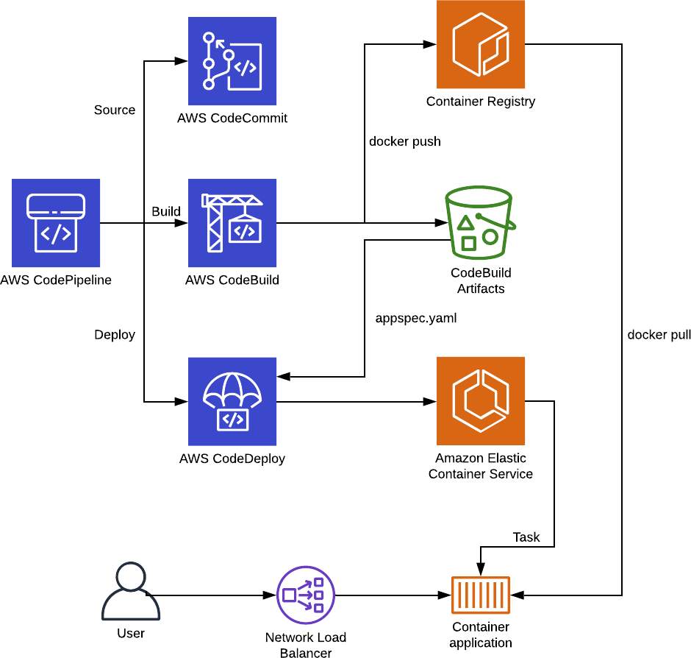

Slide 297
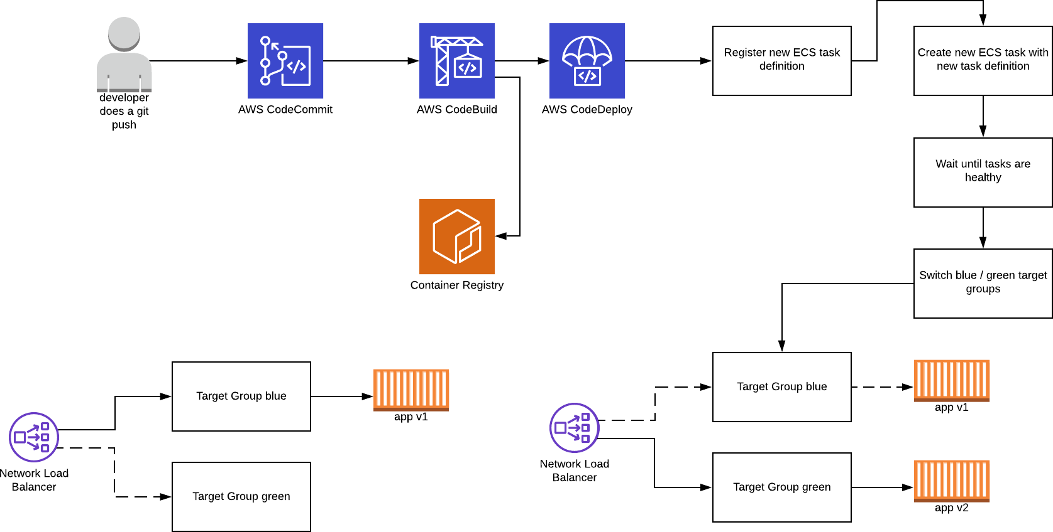

Slide 298
AWS CodePipeline
Demo

Slide 299
Advanced Module Development

Slide 300
Advanced Module Development
Up until now, I’ve shown you how to write a simple module in terraform:
"variable" declares the input for your modules
"output" declares the output, which in turn can be used in the root project, or other modules (e.g. module.mymodule.myvalue)
Resources can be stored within a module to allow easy provisioning of a logic component that consists of multiple resources (for example a database, an app with load balancer, etc)

Slide 301
Advanced Module Development
Starting from terraform 0.12 (released May 2019), module development can take on more complex tasks. It was the start of:
Better expression syntax
Better type system (better support for map, lists)
Iteration constructs (for & for_each)
This finally allowed developers to iterate over blocks (for example the tag {…} block), something that was very hard, if not impossible to do in older versions

Slide 302


Advanced Module Development
variable "conditions" {
description = "ALB rule conditions"
Example:
[
{
field = "host-header"
values = [ "mydomain.com", "www.mydomain.com" ]
}
]
default = []
type = list(object({ field = string values = list(string)
}))
}
resource "aws_lb_listener_rule" "alb_rule" { […]
dynamic condition { for_each = var.conditions content {
# First for_each loop for condition { … } block
dynamic host_header { # Second for_each loop for the host_header { … } block within the condition { … } block
for_each = condition.value.field == "host-header" ? [1] : [] content {
values = condition.value.values
}
}
}

Slide 303
Advanced Module Development
Example:
[
{
field = "host-header"
values = [ "mydomain.com", "www.mydomain.com" ]
}
]
variable "conditions" {
description = "ALB rule conditions"
default = []
type = list(object({ field = string values = list(string)
}))
}
resource "aws_lb_listener_rule" "alb_rule" { […]
condition { host_header {
# First for_each loop for condition { … } block
# Second for_each loop for the host_header { … } block within the condition { … } block
values = [ "mydomain.com", "www.mydomain.com" ]
}
}
}

Slide 304
Advanced Module Development
Starting from terraform 0.13 (August 2020), module improvement got another boost, with the support in modules for:
count
depends_on
for_each
for_each in terraform can be used to iterate over resources, just like count
With terraform 0.13, for_each and count can also be used for modules

Slide 305
The difference between count & for_each

Slide 306




Advanced Module Development
module "my_module_conditional" { count = var.enable_my_module ? 1 : 0 […]
}
module "my_module_count" {
count = ["instance1", "instance2", "instance3"] […]
}
locals { mymap = {
Instance1 = "info about my instance 1"
Instance2 = "info about my instance 2" Instance3 = "info about my instance 3"
}
}
module "my_other_module" { for_each = local.mymap instance_name = each.key […]
}
module.my_module_count[0].resource module.my_module_count[1].resource module.my_module_count[2].resource
module.my_other_module["instance1"].resource module.my_other_module["instance2"].resource module.my_other_module["instance3"].resource

Slide 307
Demo
for each with modules

Slide 308
Demo
Complex data types and the flatten() function

Slide 309
Provider Dependency Lock File
The .terraform.lock.hcl file

Slide 310
Lockfile
•
Starting from terraform 0.14 (November 2020), terraform will use a provider dependency lockfile
•
The file is created when you enter terraform init and is called .terraform.lock.hcl
•
This file tracks the versions of providers and modules
•
The lockfile should be committed to git
•
When committed to git, re-runs of terraform will use the same provider/module versions you used during execution (when terraform is ran by other members of your team, or using automation)
•
Terraform will also store checksums of the archive to be able to verify the checksum

Slide 311

Lockfile
Terraform will update the lockfile, when you make changes to the provider requirements
terraform { required_providers { aws = {
version = ">= 3.20.0"
}
}
required_version = ">= 0.14"
}

Slide 312
Lockfile
Required providers: aws: >= 3.20.0
Lock file: aws = 3.21.0
Today: terraform init
Version = 3.21.0
Latest version in registry:
aws = 3.22.0
Lock file: aws = 3.21.0
In the future: terraform init
Version = 3.21.0
In the future: After removing lock file
Latest version in registry:
aws = 3.22.0
Lock file: aws = 3.22.0
Version = 3.22.0

Slide 313
State manipulation

Slide 314
State manipulation
The command "terraform state" can be used to manipulate your terraform state file
Command Description
terraform state list List the state
Terraform state mv Move an item in the state (or rename)
terraform state pull Pull current state and output to stdout
terraform state push Overwrite state by pushing local file to statefile
terraform state replace-provider Replace a provider (e.g. aws) in the state file
terraform state rm Remove item from state
terraform state show Show item in state

Slide 315
State manipulation
Here are a few use cases when you will need to modify the state:
When upgrading between versions, for example 0.11 -> 0.12 -> 0.13
When you want to rename a resource in terraform without recreating it
When you changed a key in a for_each, but you don’t want to recreate the resources
Change position of a resource in a list (resource[0], resource[1], …)
When you want to stop managing a resource, but you don’t want to destroy the resource (terraform state rm)
When you want to show the attributes in the state of a resource (terraform state show)

Slide 316
Demo
State manipulation

Slide 317
HashiCorp Certified: Terraform Associate
HashiCorp Infrastructure Automation Certification

Slide 318
HashiCorp Infrastructure Automation Certification
Understand infrastructure as code (IaC) concepts

Slide 319
Advantaged of IaC
Infrastructure As Code
Instead of going through the UI, write code to create resources
Code will be stored in git (or other version control system)
Audit log
Ability to have a review process (PRs)
Code can be used within a Disaster Recovery process
Reusability of code
Possible automation of provisioning

Slide 320
Advantaged of Terraform
Terraform applies IaC using HCL (Hashicorp Configuration Language)
Terraform can run an execution plan to show you how the described code differs from what is actually provisioned
Terraform can resolve dependencies for you, it reads all your *.tf files at once and creates a "Resource Graph" to know what resource should be created before another resource
You know exactly what terraform will apply, using the plan & apply workflow
Terraform will only update resources that need to be changed

Slide 321
HashiCorp Infrastructure Automation Certification
More lectures coming!
Next lecture in this section will be available before 31Dec2020

Slide 322
Understand terraform basics

Slide 323
Understanding terraform basics
Terraform installation
Covered in the beginning of the course
Terraform uses providers, which are shipped separately with their own version numbering
The terraform core contains the language interpreter, the CLI, and how to interact with those providers (not the providers itself)
It doesn’t contain the code to interact with the API of the cloud providers to create resources, that code will be found in the "providers", which will be installed separately when invoking "terraform init"

Slide 324
Understanding terraform basic
The terraform registry is the main directory for providers and can be found at https://registry.terraform.io/browse/providers
The most known providers are:
Cloud providers: AWS, Azure, GCP, Oracle Cloud, Alibaba Cloud
Kubernetes, Helm
Active Directory, DNS, HTTP
Hashicorp Vault

Slide 325
Understanding terraform basic
You can immediately start using terraform resources from a specific provider (for example aws_instance), and terraform init will install this provider
Terraform by default will download the latest available version of that provider
If you want, and it’s good practice, you can specify the provider requirements in the terraform block
Besides the terraform provider requirements, you can also specify the minimum terraform version

Slide 326

Understanding terraform basic
terraform { required_providers {
aws = {
version = ">= 3.20.0"
}
}
required_version = ">= 0.14"
}
terraform { required_providers {
mycloud = {
version = ">= 1.0.0"
source = "mycorp/mycloud" # terraform cloud’s private registry (terraform-provider-mycloud)
}
}
required_version = ">= 0.14"
}

Slide 327
Understanding terraform basic
Terraform will release new breaking changes between 0.12, 0.13, 0.14, etc
Bugfixes are performed in the patch releases: 0.12.1, 0.12.2, etc
Terraform provider versioning follows semantic versioning:
MAJOR.MINOR.PATCH
PATCH = bug fixes only
MINOR = new features
MAJOR = possible breaking changes

Slide 328

Understanding terraform basic
Once you are using a provider, you can also specify provider configuration
provider "aws" { region = "us-east-1"
}

Slide 329

Understanding terraform basic
You can also use multiple providers, with the "alias" meta-argument
provider "aws" { region = "us-east-1"
}
provider "aws" { alias = "eu"
region = "eu-west-1"
}
resource "aws_instance" "myinstance" { provider = aws.eu
[…]
}
module "mymodule" { source = "./mymodule" providers = {
aws = aws.eu
}
}

Slide 330
Understand terraform basics
Provisioners

Slide 331
Understanding terraform basics
In the course we went over multiple ways of provisioning VMs:
Local-provisioner (execute something locally after spinning up a VM)
Remote-provisioner (execute something remote on the VM)
Packer (build AMI, then launch AMI)
Cloud init (using user_data, pass provisioning to AWS API so VM can provision at creation)

Slide 332
Understanding terraform basics
Provisioners (local-exec / remote-exec) are separate flows that cannot be fully controlled by terraform
Provisioners add a considerable amount of complexity and uncertainty
More coordination required: security groups need to be open, network access to the instances to run provisioning
Therefore, you should only use provisioners as last resort, when other approaches are not possible

Slide 333
Understanding terraform basics
For most use cases, you’ll be able to use cloud init
Cloud init (user_data in aws_instance), will run after the EC2 instance will launch for the first time
Other cloud providers have a similar approach (Google Cloud has metadata, Microsoft Azure custom_data, etc)
Since Kubernetes & other container orchestrators like ECS are used for provisioning, instance provisioning becomes less of an issue
Provisioning happens when building the container, then the container is launched on a container platform

Slide 334
Using terraform CLI

Slide 335
Use the terraform CLI
For the certification, you need to know about a few CLI commands (besides init / plan / apply). Let’s summarize a few of these commands in this lecture

Slide 336
Use the terraform CLI
Command Description
terraform fmt Format the *.tf files by entering "terraform fmt" or "terraform fmt filename.tf"
For example: terraform taint aws_instance.myinstance
Next time you run terraform apply the instance my instance will be destroyed and recreated
terraform taint
If you have already resources created manually and you want to manage them in terraform, then first create the terraform code in a *.tf file, then run terraform import resource_type.resource_name unique-identifier
terraform import
terraform workspace new, list, show, select and delete Terraform workspaces
terraform state
Manipulate the terraform state file. You can move (mv), remove (rm), list, pull, push, replace-provider within the state, and show the state

Slide 337

Use the terraform CLI
Terraform starts with a single workspace "default"
You can create a new workspace using "terraform workspace new"
$ terraform workspace new mytestworkspace
Created and switched to workspace "mytestworkspace"!
You're now on a new, empty workspace. Workspaces isolate their state,
so if you run "terraform plan" Terraform will not see any existing state for this configuration.
Switching to another workspace (or back to default) can be done with "terraform workspace select name-of-workspace"

Slide 338
Use the terraform CLI
Once your are in a new workspace, you’ll have an "empty" state
Your previous state is still accessible if you select the "default" workspace again
When you run terraform apply in your new workspace you will be able to re- create all the resources, and those resources will be managed by this new state in this new workspace
This can be useful if you for example want to test something in your code without making changes to your existing resources, for example create a new instance with encrypted root devices in a new workspace to test whether your new code works, rather than immediately trying this on your existing resource

Slide 339

Use the terraform CLI
To avoid naming collisions you can use the variable terraform.workspace
resource "aws_ssm_parameter" "my-parameter" { name = "/myapp/myname-${terraform.workspace}"
[…]
}
Or only enable resource creation in a specific workspace:
resource "aws_instance" "myinstance" {
count = terraform.workspace == "default" ? 1 : 0
[…]
}

Slide 340
Use the terraform CLI
The workspaces cannot be used for a "fully isolated" setup that you’d need when you want to run terraform for multiple environments (staging / testing / prod)
Even though a workspace gives you an "empty state", you’re still using the same state, the same backend configuration (workspaces are the technically equivalent of renaming your state file)
Therefore workspaces only have limited use cases
In real world scenarios you typically use re-usable modules and really split out the state over multiple backends (for example your staging backend will be on s3 on your staging AWS account, and your prod backend will be in an s3 bucket on the prod AWS account, following multi-account strategy)

Slide 341
Use the terraform CLI
If something goes really wrong, you hit a bug, or terraform just "hangs", you might want to enable debugging mode
To enable more logging, you need to set the TF_LOG environment variable
You can also prepend it to the terraform command on MacOS / Linux like this: TF_LOG=DEBUG terraform apply
On windows, in Powershell, you can use:
$Env:TF_LOG = "DEBUG"

Slide 342
Use the terraform CLI
Valid log levels are:
TRACE
DEBUG
INFO
WARN
ERROR

Slide 343
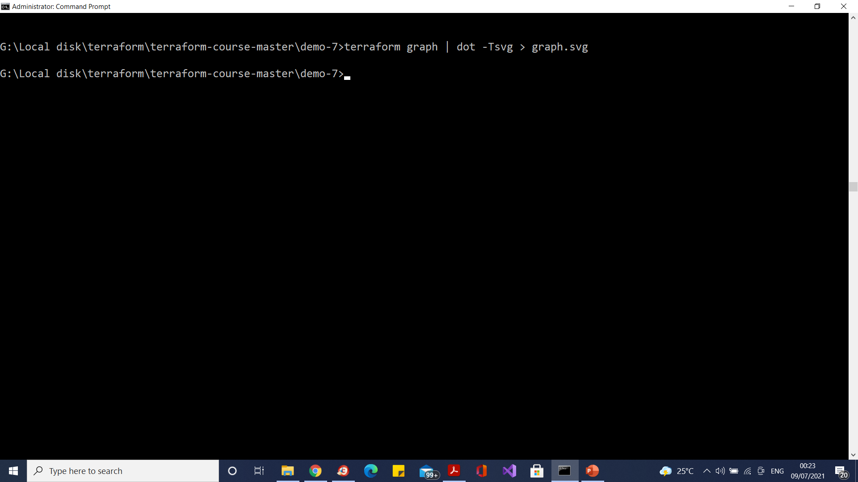
Terraform Graph

Slide 344
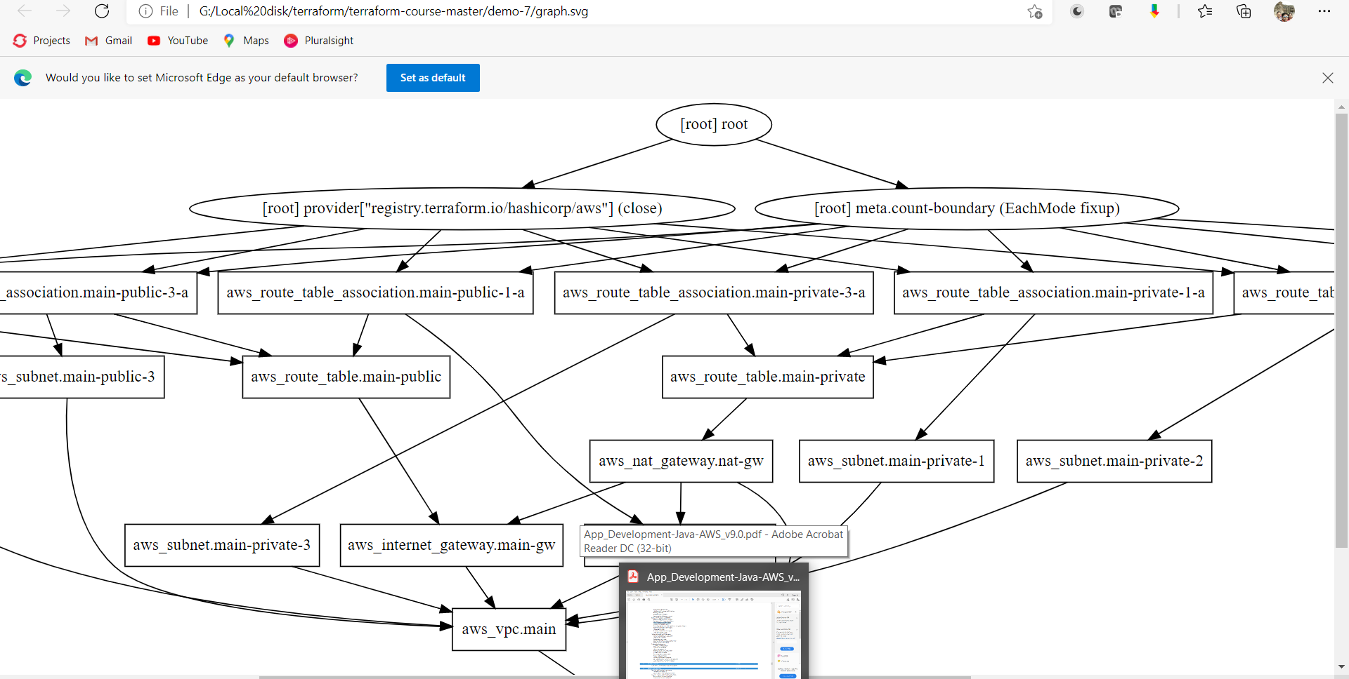
Terraform Graph

Slide 345
Interact with Terraform modules

Slide 346

Interact with Terraform modules
In this course, we covered a lot of material on modules, so let’s rehearse what we learned in this lecture
This is a typical module declaration:
module "consul" {
source = "hashicorp/consul/aws" version = "0.1.0"
}
This will download a specific module version from the terraform registry
We can also see that the module is owned by hashicorp, because it starts with hashicorp/

Slide 347
Interact with Terraform modules
Source Description
Terraform registry:
<NAMESPACE>/<NAME>/<PROVIDER>
hashicorp/consul/aws
Namespace = hashicorp name = consul provider = aws
When no hostname is provided registry.terraform.io is assumed. A private registry example could be: registry.mycorp.com/myteam/ myspecialmodule/aws
Terraform private registry:
<HOSTNAME>/<NAMESPACE>/<NAME>/
<PROVIDER>
If you’re using a private registry, you might have to specify an access token in the CLI Config (terraform.rc in %APPDATA% in
Windows, .terraform.rc on linux/Mac systems)
See https://www.terraform.io/docs/commands/cli-config.html#credentials

Slide 348
Interact with Terraform modules
You don’t necessarily need to use the registry, you can also use the modules directly if you create a directory for example:
module "mymodule" {
source = "./mymodule" # refers to a local path
}

Slide 349
Interact with Terraform modules
Terraform will also recognize GitHub (HTTPS):
module "mymodule" {
source = "github.com/in4it/terraform-modules"
}
And also over SSH:
module "mymodule" {
source = "git@github.com:in4it/terraform-modules.git"
}
These examples work with bitbucket as well (replace GitHub.com in bitbucket.org)

Slide 350

Interact with Terraform modules
More examples:
module "mymodule" {
source = "git::https://example.com/mymodule.git"
}
module "mymodule" {
source = "git::ssh://username@example.com/mymodule.git"
}
module "mymodule" {
source = "git::https://example.com/mymodule.git?ref=v1.3.0"
}
module "mymodule-over-https" {
source = "https://example.com/mymodule.zip"
}
module "mymodule-in-s3" {
source = "s3::https://s3-eu-west-1.amazonaws.com/examplecorp-terraform-modules/mymodule.zip"
}

Slide 351
Interact with Terraform modules
Passing input:
module "mymodule" { source = "./mymodule" myValue = "123"
}
In ./mymodule/vars.tf:
variable "myValue" {
}

Slide 352

Interact with Terraform modules
Getting output:
module "mymodule" { source = "./mymodule" myValue = "123"
}
module "other_module" {
public_ip = module.mymodule.instance_public_ip
}
In ./mymodule/output.tf:
output "instance_public_ip" {
value = aws_instance.myinstance.public_ip
}

Slide 353
Interact with Terraform modules
In a module you can only use the variables that are declared within that module
In the root module (the root project), you can only access parameters that are defined as output in that module
To access data from the root module or other modules, you can use inputs
to pass information to the module
To provide data to the root module, you can use outputs to pass information to the root module

Slide 354
Terraform Module Registry

Slide 355
Terraform Module Registry
When using modules (and also providers), you can specify a version constraint
version = ">= 1.2.0, < 2.0.0"
•
This version allows every version greater or equal than 1.2.0, but needs to be less than 2.0.0
•
You can separate conditions with a comma
•
The version numbering should follow semantic versioning (major.minor.patch)

Slide 356
Terraform Module Registry
The following operators can be used with version conditions
• = (the default, so you can as well remove it): Exactly one version
"=1.0.0" or "1.0.0"
!= : Excludes an exact version
For example when there’s a known bug in a specific version
>, >=, <, <=: Greater than, greater than or equal, less than, less than or equal
~>: Allows right most version to increment

Slide 357
Terraform Module Registry
~>: Allows right most version to increment
"~> 1.2.3" will match 1.2.4, 1.2.5, but not 1.3.0
"~>1.2" will match 1.3, 1.4, but not 2.0

Slide 358
Terraform Module Registry
Best practices
Terraform documentation recommends to use specific versions for third party modules (so that you can upgrade when convenient only)
For modules within your organization, you can use a range, for example "~>1.2.0" to avoid big changes when you bump to 1.3.0 (you can then bump when you need new features)
Within modules (when you write a module), you should supply a minimum terraform core version to ensure compatibility (e.g. >=1.14.0)
For providers you can use the ~> constraint to set lower and upper bound
For example ~> 3.21 on the AWS module will still give you new features, but will not introduce a major bump

Slide 359
Navigate terraform workflow

Slide 360
Navigate terraform workflow
Write
Plan
Apply (Create)

Slide 361
Navigate terraform workflow
terraform init
terraform validate
terraform apply (in console)
terraform plan planfile
terraform apply planfile (-auto-approve)

Slide 362
Navigate terraform workflow
terraform plan -target address planfile
terraform apply planfile

Slide 363
Implement and maintain state

Slide 364
Implement and maintain state
The default backend in terraform is the local backend, this requires no configuration
A terraform.tfstate file will be written to your project folder
This is where the state is stored
Every time you run terraform apply, the state will be changed, and the file will be updated
Once you start working in a team, you are going to want to use a remote backend

Slide 365
Implement and maintain state
Working with a remote state has benefits:
You can easily work in a team, as the state is separate from the code (alternatively, you would have to commit the state to version control - which is far from ideal if you need to work in a team)
A remote backend can keep sensitive information off disk
S3 supports encryption at rest, authentication & authorization, which protects your state file much more than having it on your disk / version control
Remote operations: terraform apply can run for a long time in bigger projects. Backends, like the "remote" backend, supports remote operations that are executed fully remote, so that the whole operation runs asynchronously. You don’t need to be connected / keep your laptop running during the terraform apply (more about that in the Terraform Cloud lecture)

Slide 366
Implement and maintain state
Local backend (local file on disk)
Local locking (-lock file)
Terraform
Terraform init
remote backend (e.g. s3)
Dynamodb locking
s3: at rest encryption, versioning

Slide 367
Implement and maintain state
State locking ensures nobody can write to the state at the same time
Sometimes, when terraform crashes, or a users’ internet connection breaks during terraform apply, the lock will stay
"terraform force-unlock <id>" can be used to force unlock the state, in case there is a lock, but nobody is running terraform apply
This command will not touch the state, it’ll just remove the lock file, so it’s safe, as long as nobody is really still doing an apply
There’s also an option -lock=false that can be passed to terraform apply, which will not use the lock file. This is discouraged and should only be used when your locking mechanism is not working

Slide 368
Implement and maintain state
Supported standard backends:
Artifactory (artifact storage software)
Azurerm (azure)
Consul (hashicorp key value store)
Cos (Tencent cloud)
Etcd, etcdv3 (similar to consul)
Gcs (google cloud)

Slide 369
Implement and maintain state
Supported standard backends:
http
Kubernetes
Manta (also object storage)
oss (Alibaba cloud storage)
pg (postgres)
S3
Swift (openstack blob storage)

Slide 370


Implement and maintain state
Every backend will also have a specific authentication method (which is explained in the terraform docs on a per backend basis)
The configuration is done within the terraform {} block:
terraform {
backend "azurerm" {
terraform { backend "s3" {
bucket = "mybucket"
key = "path/to/my/key" region = "eu-west-1"
}
}
 | storage_account_name container_name key use_msi | = = = = | "abcd1234" "tfstate" "prod.terraform.tfstate" true
 | subscription_id | = | "00000000-0000-0000-0000-000000000000"
 | tenant_id | = | "00000000-0000-0000-0000-000000000000"
}
}

Slide 371
Implement and maintain state
You can have a partial backend configuration, where you leave away some of the information
This can be useful if you would like to use different backends when executing the code (for example for staging / qa / prod environments)
This is often then scripted with shell scripts that call terraform with the correct arguments - this to avoid having to do this manually every time
Most commonly this is used to avoid having to hardcode secrets in the terraform files, which would end up in version control

Slide 372

Implement and maintain state
There are 3 ways to pass this backend information:
Interactively, when the information is missing, terraform init will ask for it (only works for required values in the backend configuration)
A file
Key/Value Pairs
$ | terraform | init | -backend-config=path-to-file
$ | terraform | init | -backend-config="bucket=mybucket" | -backend-config="otherkey=othervalue"

Slide 373
Implement and maintain state
If at some point you’d like to update your state file to reflect the "actual" state of your infrastructure, but you don’t want to run terraform apply, you can run "terraform refresh"
Terraform refresh will look at your infrastructure that has been applied and will update your state file to reflect any changes
It’ll not modify your infrastructure, it’ll only update your state file
This is often useful if you have outputs that need to be refreshed, or something changed outside terraform and you need to make terraform aware of it without having to run an apply

Slide 374
Implement and maintain state
You need to be aware that secrets can be stored in your state file
For example when you create a database, the initial database password will be in the state file
If you have a remote state, then locally it’ll not be stored on disk (it’ll only be kept in memory when you run terraform apply)
As a result, storing state remote can increase security
Make sure your remote state backend is protected sufficiently
For example for s3, make sure only terraform administrators have access to this bucket, enable encryption at rest. Also make sure that for every backend TLS is used when communicating with the backend (is on by default on s3)

Slide 375
Read, generate, and modify configuration
Input, output, locals

Slide 376
Configuration
There are 3 types of variables in terraform:
Input variables
variable "a-variable" { … }
Output variables
output "an-output" { … }
Local variables (locals { …} )
They are like a temporary variables that you can use
Used for calculations, concatenations, conditionals where the result is later used within the resources

Slide 377
Configuration
Input variables can have the following optional arguments:
default
type
description
validation
sensitive

Slide 378
Configuration
Type constraints:
string
number
bool

Slide 379
Configuration
Complex types:
list(<TYPE>)
set(<TYPE>)
map(<TYPE>)
object({<ATTR NAME> = <TYPE>, …})
tuple([<TYPE>, …])
"any" can be used as a type as well to indicate any type is acceptable

Slide 380

Implement and maintain state
Let’s go over a few examples of variables
variable "myvariable" {
description = "this is myvariable, it’s a string" type = string
default = "123"
}
// from the module-flatten demo variable "parameters" {
type = list(object({ prefix = string
parameters = list(object({ name = string
value = string
}))
}))
default = []
}

Slide 381

Implement and maintain state
variable "docker_ports" { type = list(object({ internal = number external = number protocol = string
}))
default = [
{
internal = 8300
external = 8300 protocol = "tcp"
}
]
}

Slide 382

Implement and maintain state
Since terraform 0.13, there is also support for validation rules (which is very handy when developing modules):
variable "image_id" { type = string
description = "The id of the machine image (AMI) to use for the server."
validation { condition
= length(var.image_id) > 4 && substr(var.image_id, 0, 4) == "ami-"
error_message = "The image_id value must be a valid AMI id, starting with \"ami-\"."
}
}

Slide 383


Implement and maintain state
You can also use "sensitive" in input variables, to prevent terraform from outputting the variable during plan & apply
This is useful if you’re handling secrets (user info, password information) in a variable:
variable "password" { type = string sensitive = true
}
resource "resource_type" "resource_name" { parameter = var.password
}
Terraform will perform the following actions: # resource_type.resource_name will be created
+ resource "resource_type" "resource_name" {
+ parameter = (sensitive)
}
Plan: 1 to add, 0 to change, 0 to destroy.

Slide 384

Implement and maintain state
There’s one exception: if your sensitive information becomes part of the identifier (id) of the resource, it’ll be disclosed:
# resource_type.resource_name will be created
+ resource "resource_type" "resource_name" {
+ id = (known after apply)
+ parameter = (sensitive)
}
Plan: 1 to add, 0 to change, 0 to destroy.
...
resource_type.resource_name: Creating...
resource_type.resource_name: Creation complete after 0s [id=my-sensitive-information]

Slide 385

Configuration
Output variables have a mandatory argument: value
The following are optional arguments:
description
output "password" {
value = resource_type.resource_name.password
sensitive
depends_on
description = "The password for logging in." sensitive = true
}

Slide 386

Configuration
In rare cases you need depends_on to depend on another resource, before outputting the value
It works in the same way as "depends_on" in regular resources:
output "password" {
value = resource_type.resource_name.password description = "The password for logging in." sensitive = true
depends_on = [resource_type.another_resource_name]
}

Slide 387
Configuration
Local values can be useful to avoid repeating the same values
I find it can also help you to move some complexity away from the resource itself for readability (when doing for/for_each loops for example)
You should only use local values in moderation, as it can be a bit harder for maintainers to figure out where the values come from

Slide 388


Configuration
resource "aws_instance" "group1" { count = var.group1_count
…
}
resource "aws_instance" "group2" { count = var.group2_count
…
}
locals {
instance_ids = concat(aws_instance.group1.*.id, aws_instance.group2.*.id)
}
resource "aws_ssm_parameter" "parameter" { name = "instance_ids"
value = join(",", local.instance_ids) type = "String"
}

Slide 389
Read, generate, and modify configuration
Resources and data sources

Slide 390
Configuration
In terraform, you can create "resources" and "datasources"
Datasources allow data to be fetched or computed from outside of
terraform
For example, an AMI list that can be filtered to extract AMI IDs, or the lookup of an external VPC to retrieve the VPC ID
Resources, unlike datasources, describes one or more infrastructure objects
They typically create infrastructure components, like an EC2 resource, or a VPC subnet, a database

Slide 391

Configuration
data "aws_ami" "ubuntu" { most_recent = true
filter {
name = "name"
values = ["ubuntu/images/hvm-ssd/ubuntu-bionic-18.04-amd64-server-*"]
}
filter {
name = "virtualization-type" values = ["hvm"]
}
owners = ["099720109477"] # Canonical
}
resource "aws_instance" "example" {
ami = data.aws_ami.ubuntu.id
instance_type = "t2.micro" […]
}

Slide 392

Configuration
data "aws_subnet" "my-external-subnet" { filter {
name = "tag:Name"
values = ["not-managed-by-terraform-subnet-name"]
}
}
resource "aws_instance" "example" {
ami = data.aws_ami.ubuntu.id instance_type = "t2.micro"
[…]
subnet_id = data.aws_subnet.my-external-subnet.id
}
aws_subnet
aws_instance
depends on

Slide 393

Configuration
aws_subnet
aws_security_group
depends on
aws_instance
depends on
aws_eip
aws_key_pair
resource "aws_instance" "example" { […]
vpc_security_group_ids = aws_security_group.example.id
}
resource "aws_eip" “eip" {
instance = aws_instance.example.id
vpc = true
}
aws_ami

Slide 394

Configuration
If for some reason normal dependency management by terraform doesn’t work, you can force a resource to depend on another resource
This can be done using the keyword “depends_on”
depends_on expects a list of other resource names:
resource "aws_instance" "example" { […]
vpc_security_group_ids = aws_security_group.example.id
depends_on = [aws_instance.another-instance, aws_s3_bucket.a-bucket]
}

Slide 395
Configuration
During terraform apply, terraform will:
Refresh the data sources
Create resources that exist in the *.tf files, but not in the state file
Destroy resources that exist in the state, but not in the *.tf files
Update resources that have different arguments in the *.tf files than on the cloud provider
Destroy and re-create resources that have arguments changed that require re- creation (for example a change to user_data in an ec2 instance always needs re- creation)
In-place updates are possible if the infrastructure API supports it (update to a security group for example)

Slide 396
Configuration
Resources can be addressed using:
<RESOURCE TYPE>.<NAME>.<ATTRIBUTE>
Data sources can be addressed using:
data.<RESOURCE TYPE>.<NAME>.<ATTRIBUTE>
Local resources can be addressed using:
local.key_name

Slide 397

Configuration
resource "aws_instance" "example" {
ami = data.aws_ami.ubuntu.id […]
ebs_block_device { device_name = "sda2" volume_size = 100
}
ebs_block_device { device_name = "sda3" volume_size = 200
}
}
aws_instance id: aws_instance.example.id (but also aws_instance.example.ami will work)
aws_instance.example.ebs_block_device[*].id (splat expression) which is the same as:
[for block_device in aws_instance.example.ebs_block_device: block_device.id]

Slide 398
Configuration
There is an older variant that should be avoided in newer configuration:
It’s called the attribute only splat expression:
var.list.*.interfaces[0].name
Which is the equivalent to:
[for o in var.list : o.interfaces][0].name
For now this still works in terraform (0.14), but only for legacy reasons

Slide 399
Configuration
You can use functions in terraform to create all different sorts of behaviour
Numeric functions (min, max, …)
String functions (formatting strings)
Collection functions (merging lists, maps)
Encoding functions (base64, json, yaml)
Date and Time functions
Hash and crypto functions (uuid, SHA)
IP Network functions (subnet calculations)
Type conversion (tolist, tomap, toset, …)

Slide 400

Configuration
For and for_each can help you to iterate over variables
count / for_each at a resource level can create multiple instances of a resource
resource "aws_instance" "example" {
count = var.amount_of_example_instances […]
}
•
Dynamic blocks can iterate over blocks
•
For loops can iterate over complex data types and output a specific value (as a value of a parameter, or as a value in locals { … })

Slide 401

Configuration
locals {
my_result = [ for x in var.y: x.id ]
}
resource "resource_type" "resource_name" { parameter = local.my_result
}

Slide 402
Read, generate, and modify configuration
Secret injection

Slide 403
Configuration
When you create a user (for the terraform operator) in AWS, you get long lived AWS credentials
In general, long lived credentials are to be avoided
There are multiple ways to avoid using long lived credentials

Slide 404
Configuration
For AWS, you can use Federation, with AWS SSO, or a third party, to avoid the need of users
You’ll then work with “roles” rather than users, which provides you with short-lived credentials
It’s a out of scope to discuss the implementations of these tools, have a look at AWS SSO, Okta, Onelogin, Azure AD, SAML to get an idea of the possibilities
Other Cloud providers work in similar ways, and offer their own ways to do federation

Slide 405
Configuration
Another solution would be to run terraform on one of your cloud providers’ instances
This allows you to use the identities provided by the cloud provider (in AWS that is “instance profiles” using “AWS IAM Roles”)
This will also avoid the need of long lived credentials, as short lived credentials will be automatically retrieved on the instance
AWS works with a metadata endpoint that you can reach to get temporary credentials on an AWS EC2 instance. This is also supported within the terraform-aws-provider
Other cloud providers work in similar ways

Slide 406
Configuration
Another solution (one that Hashicorp recommends), is the use of
HashiCorp Vault
You can still use long-lived credentials, and store these in HashiCorp Vault
Vault can then issue short-lived credentials for your terraform operations
To make this happen, Vault will dynamically create AWS credentials
See https://learn.hashicorp.com/tutorials/terraform/secrets-vault? in=terraform/secrets for more information about this approach

Slide 407
Terraform cloud

Slide 408
Terraform Cloud
Terraform cloud is a HasiCorp product
It helps teams use terraform together
Instead of running terraform from your own machine, or on your own Jenkins, Terraform Cloud will run terraform on their machines in a consistent and reliable environment
You have easy access to shared state, version control integration, secret data, access controls for approving changes to infrastructure, policy controls and other enterprise features
It includes a private terraform registry to share terraform modules

Slide 409
Terraform Cloud
Terraform cloud is hosted at https://app.terraform.io/
You can create a free account for small sized teams
There are paid plans for medium size businesses
For large enterprises terraform has “Terraform Enterprise”, which is the self-hosted version of Terraform cloud (to run within your own environment)

Slide 410
Terraform Cloud
Terraform Cloud workspaces are different than the local terraform workspaces
When you locally use workspaces, you’re still in the same directory, using the same variables and credentials. The state is empty for every new workspace, but the state is just another file within the same project
With Terraform Cloud Workspaces, it’s much more isolated. It’s much more like a separate “project” with its own variables, secrets, credentials, and state
The state also supports multiple versions, so you can see the previous state versions, and how they match with a specific terraform run
Terraform recommends to use workspaces in Terraform Cloud to split your monolithic terraform project in smaller projects, for example split out networking, different apps

Slide 411
Terraform Cloud
Terraform Sentinel is a paid feature, available in Terraform Cloud
Sentinel is an embedded policy-as-code framework integrated with the other HashiCorp Enterprise products
Sentinel allows administrators to write policy rules to put controls in place to protect or restrict what can be applied to the infrastructure

Slide 412
Terraform Cloud
A few use cases:
Only allow a subset of aws_ami owners so only “Amazon” or “Ubuntu” images can be launched on AWS
Enforce that every resource needs to be tagged
Disallow 0.0.0.0/0 in security group rules
Restrict EC2 instance types
Require S3 buckets to be encrypted with a KMS key
Allow only specific providers in terraform
Limit proposed monthly cost

Slide 413

Configuration
# This policy uses the Sentinel tfstatev2 import to restrict the owners set on # all instances of the aws_ami data source in all modules
# Import common-functions/tfstate-functions/tfstate-functions.sentinel # with alias "state"
import "tfstate-functions" as state
# Allowed Owners
# Include "null" to allow missing or computed values allowed_owners = ["self", "099720109477", "099720109478"]
# Get all AMIs
allAMIs = state.find_datasources("aws_ami")
# Filter to AMIs with violations
# Warnings will be printed for all violations since the last parameter is true violatingAMIs =
state.filter_attribute_contains_items_not_in_list(allAMIs, "owners", allowed_owners, true)
# Main rule main = rule {
length(violatingAMIs["messages"]) is 0
}

Slide 414
Congratulations

Slide 415

Congratulations

